Slide 1
Potato Tower 200 L plastic drums
April 2016

Slide 2
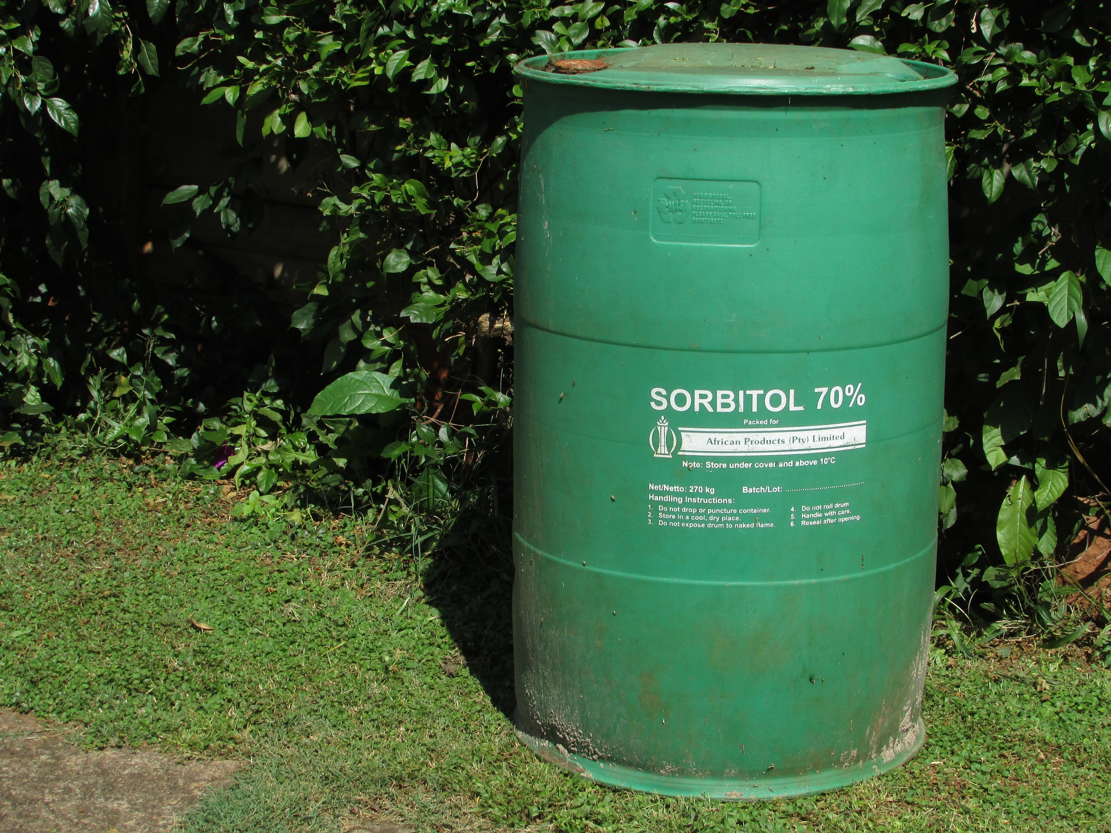
Top third will be used
for the potato tower
Bottom two thirds become
a bacteria generator

Slide 3
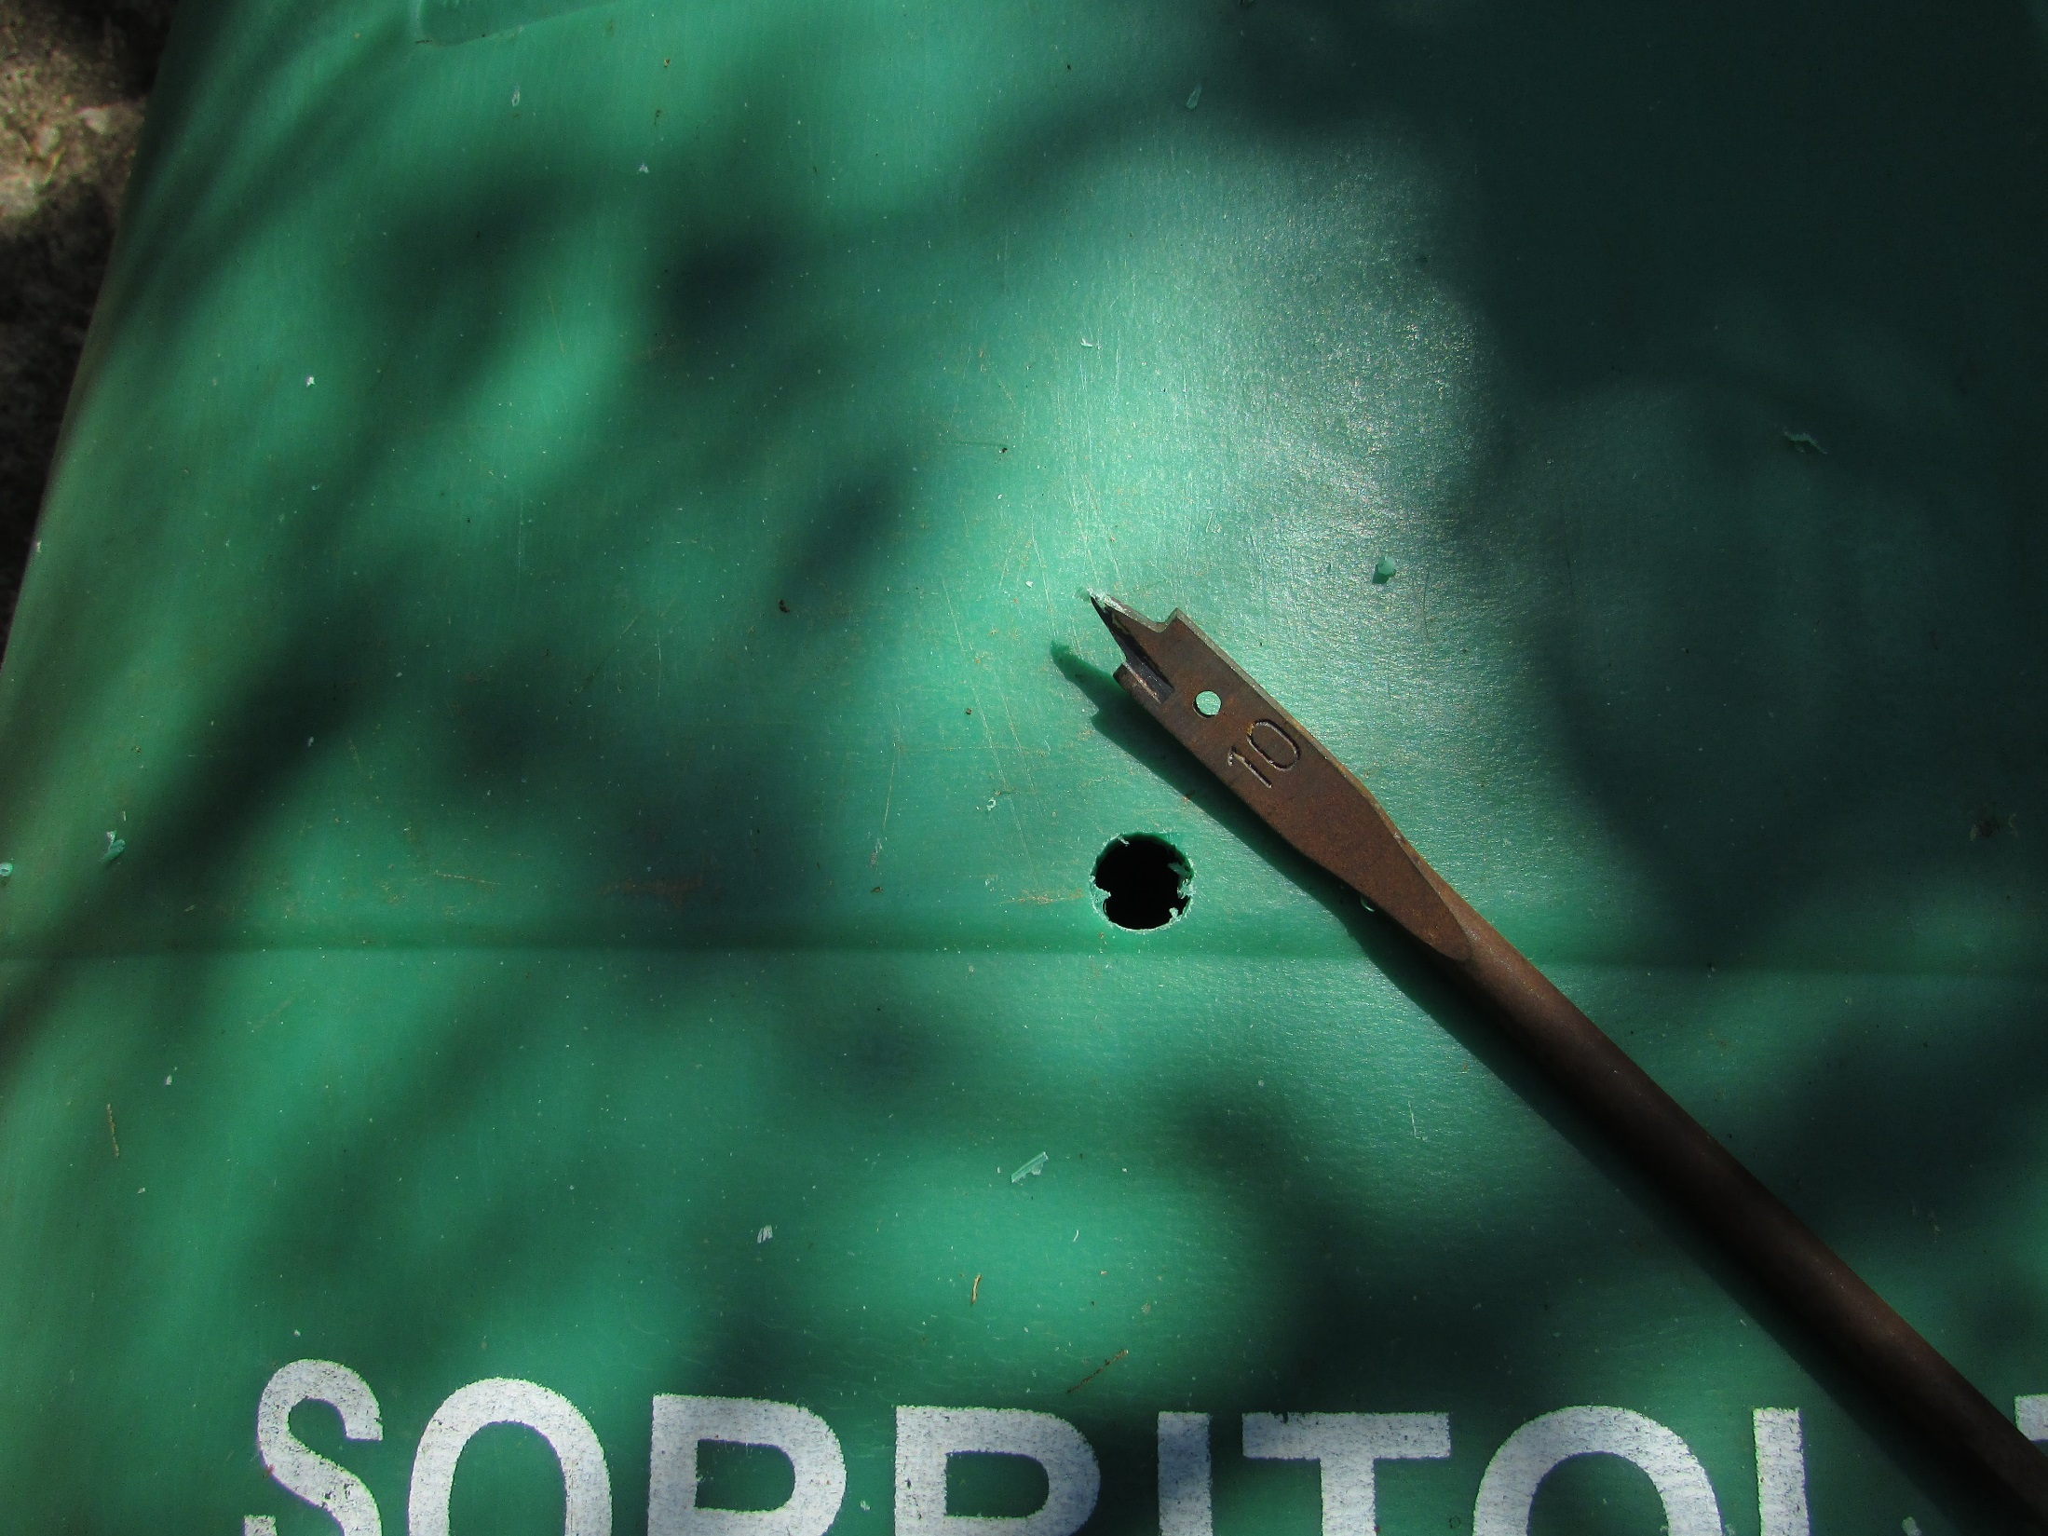
Drill a 10 mm starter hole

Slide 4
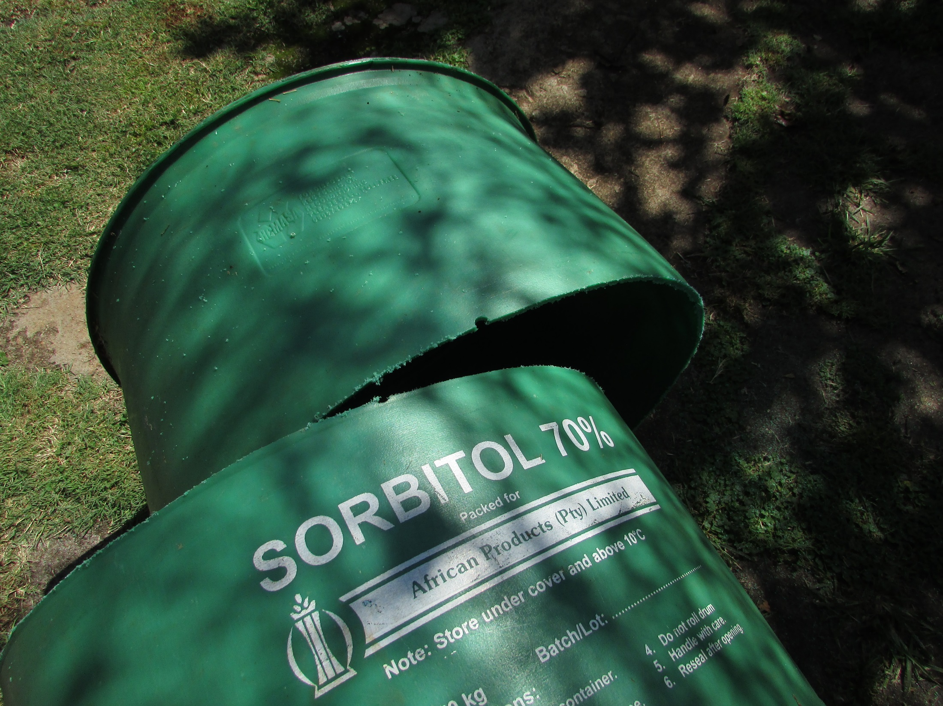
Cut with a jig saw

Slide 5
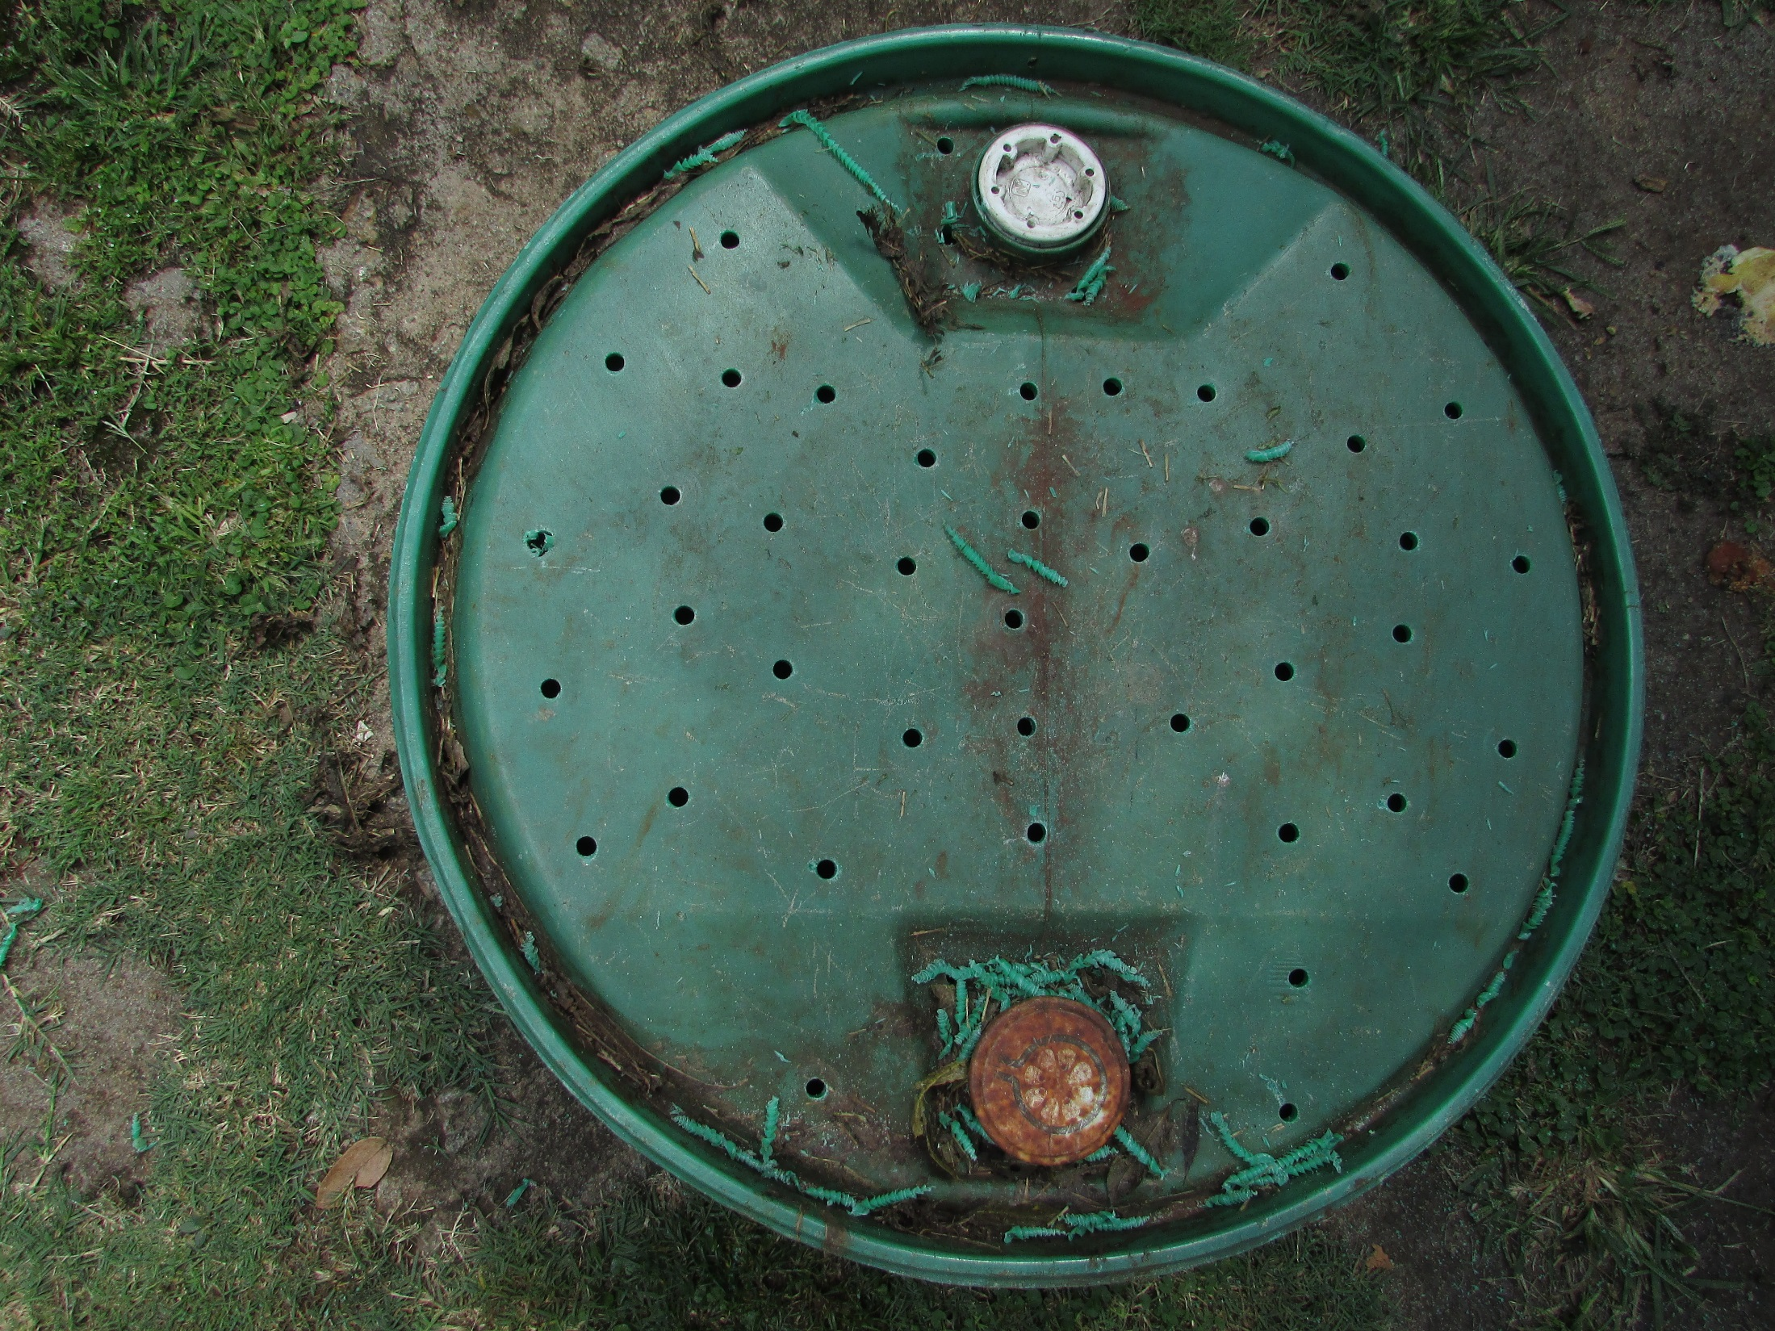
Drill 10mm drainage holes

Slide 6
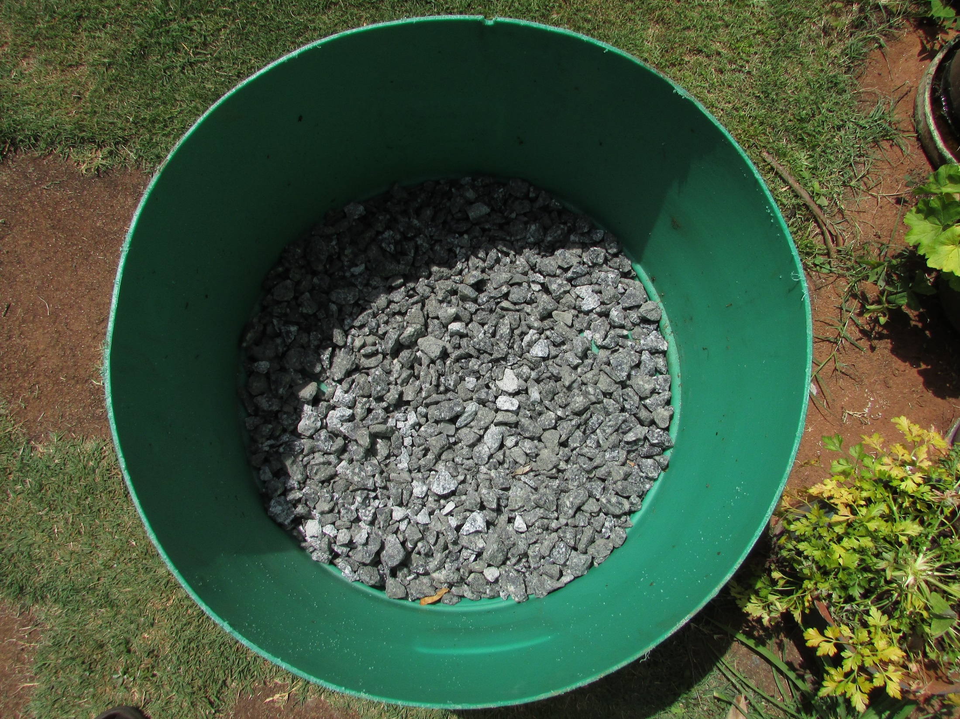
Add gravel or rocks

Slide 7
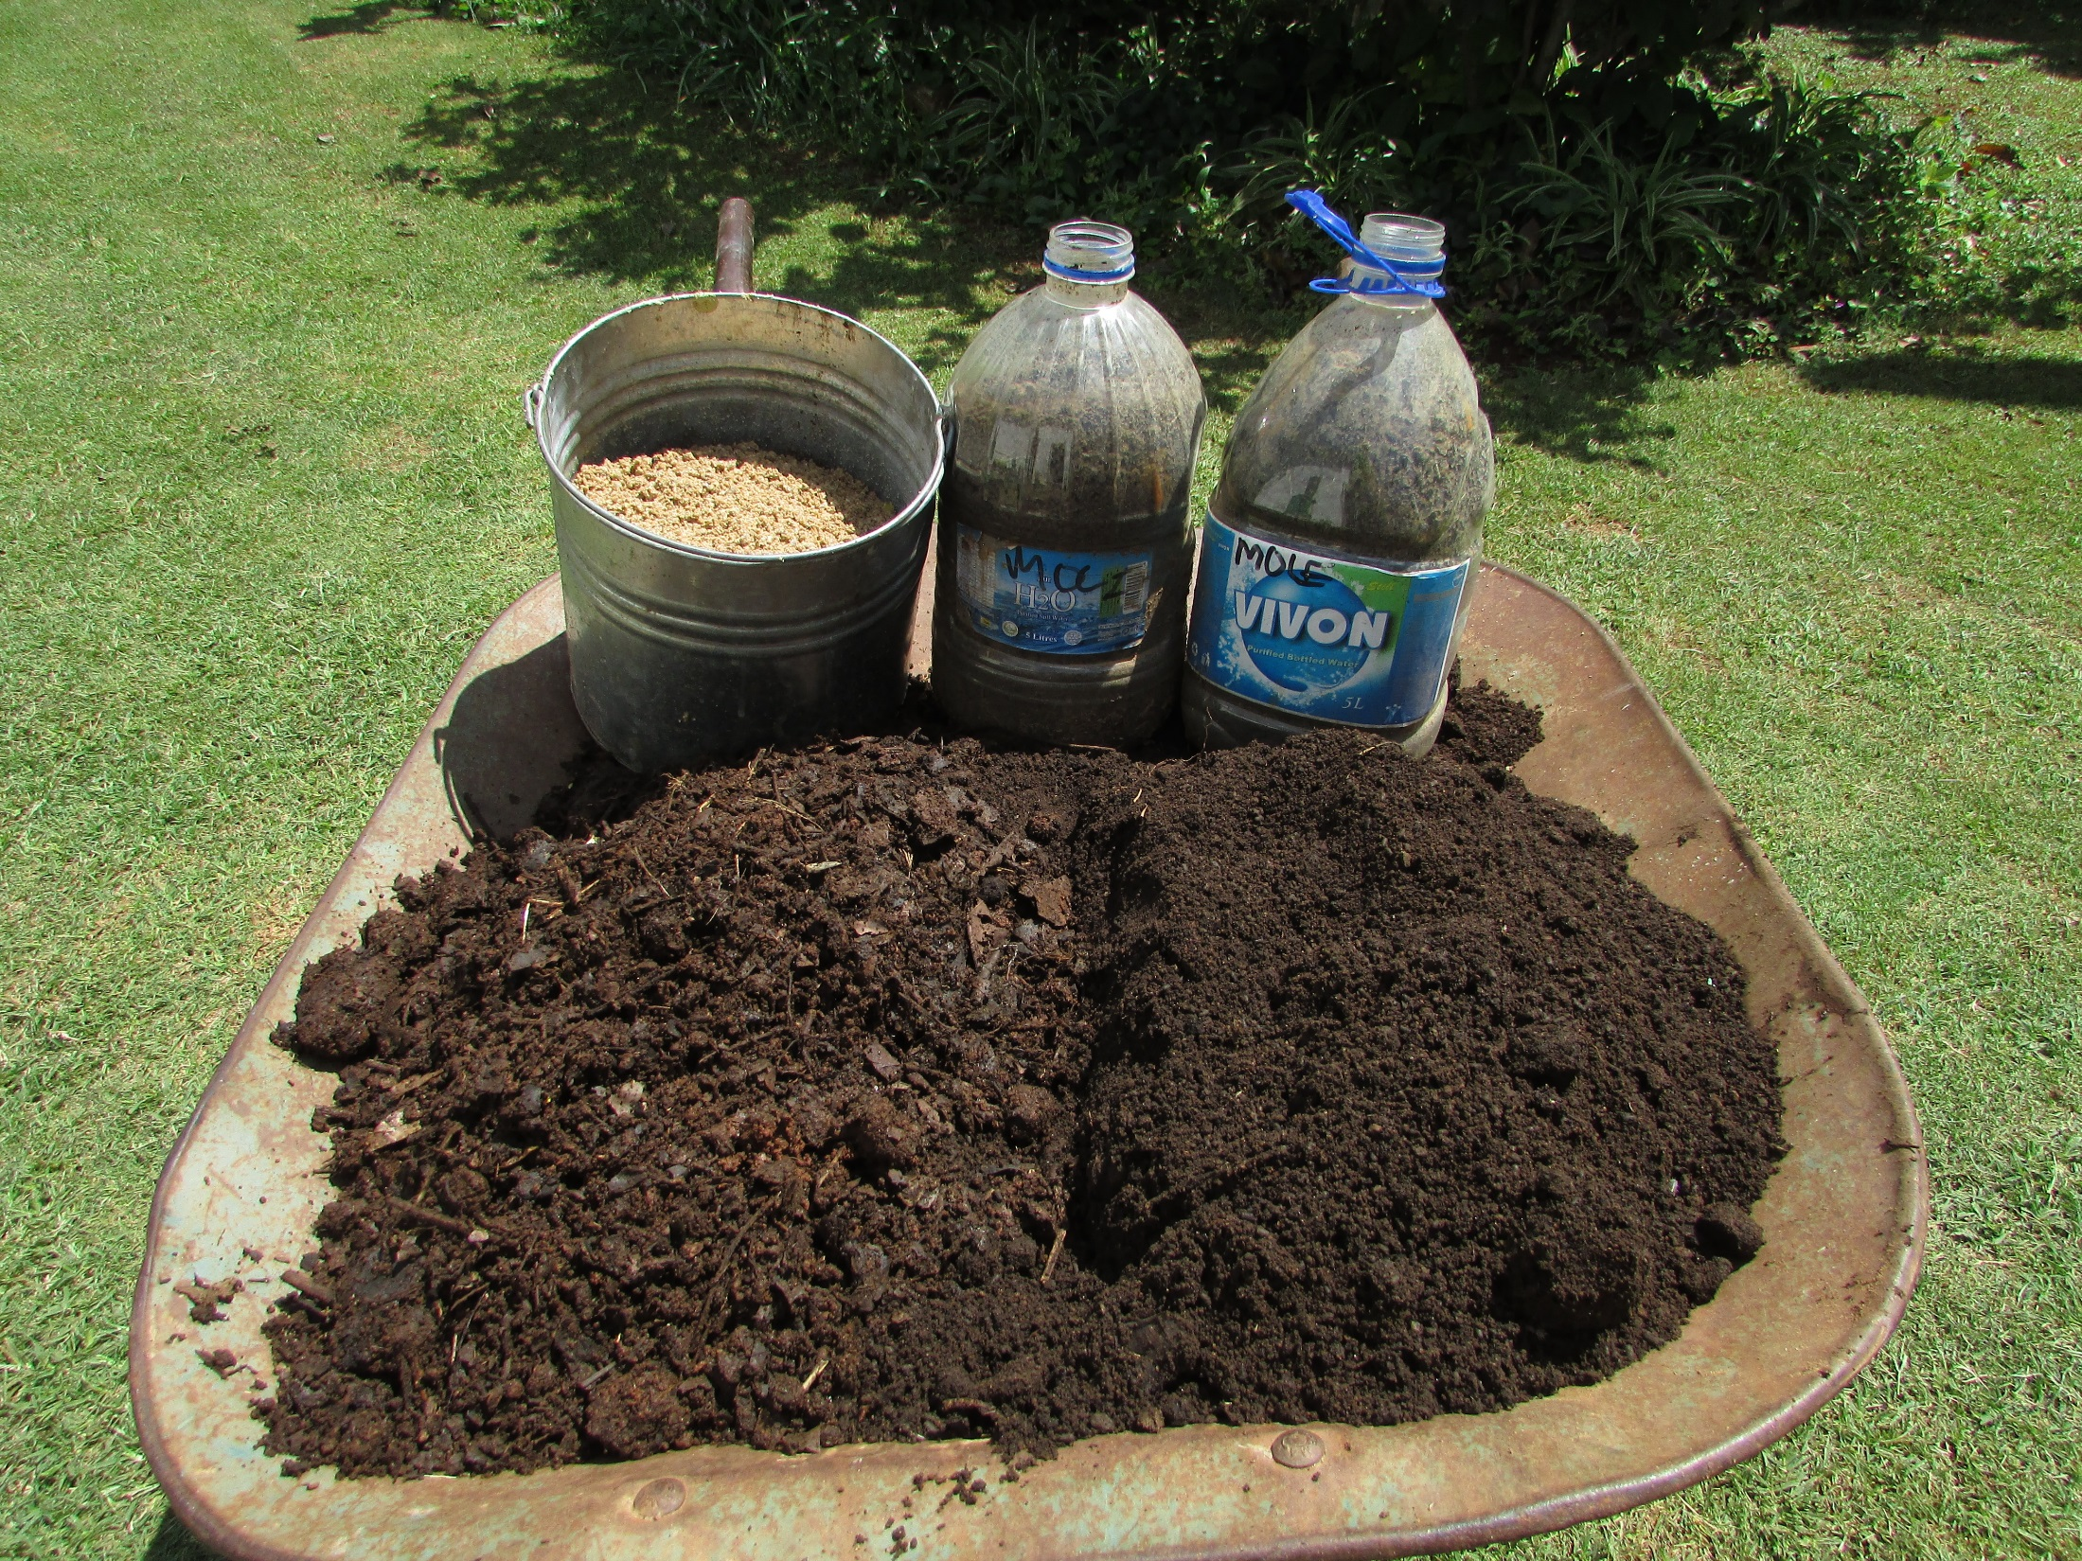
10 kg river sand
10 kg mole hills
25 kg compost
25 kg top soil

Slide 8
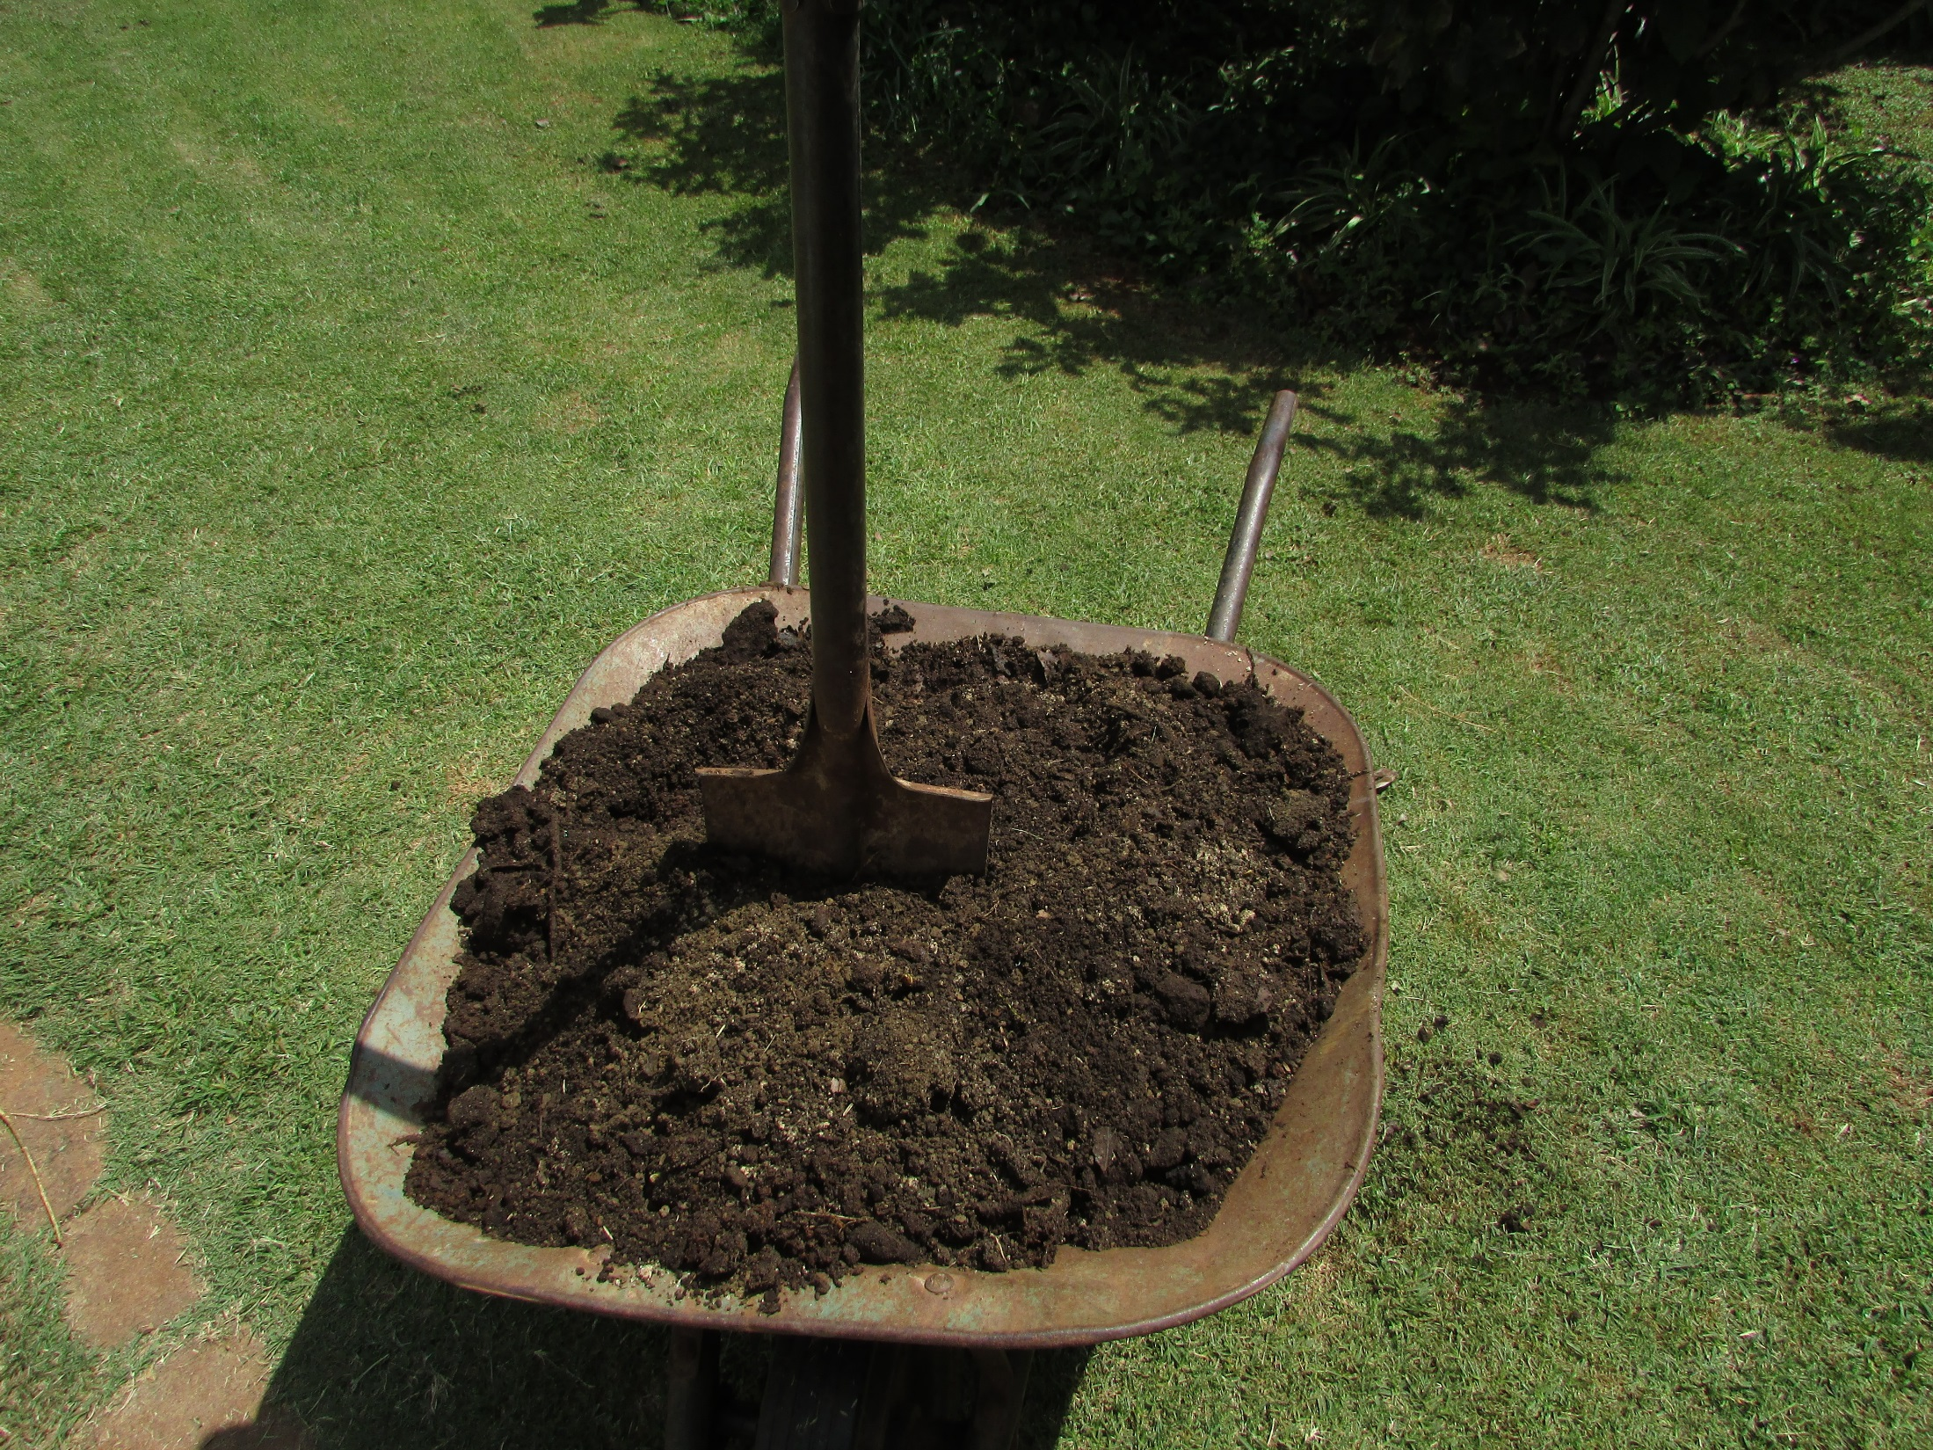
Mix thoroughly

Slide 9
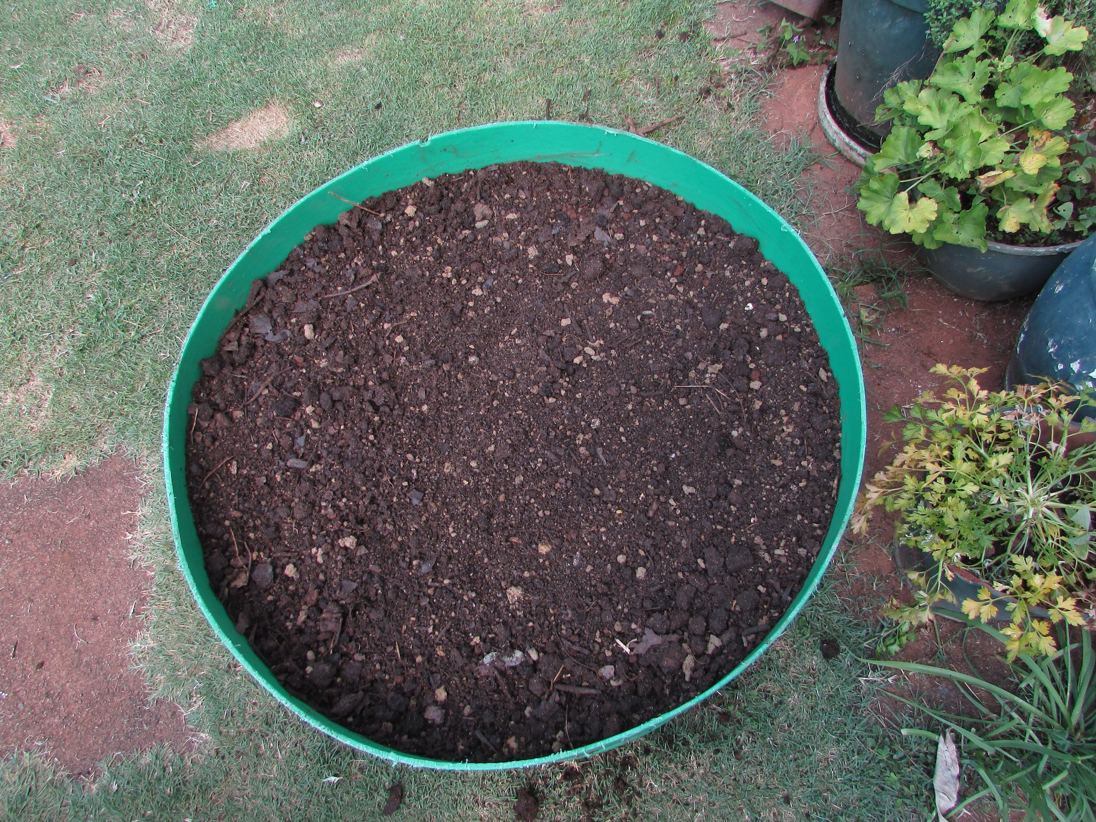

Slide 10
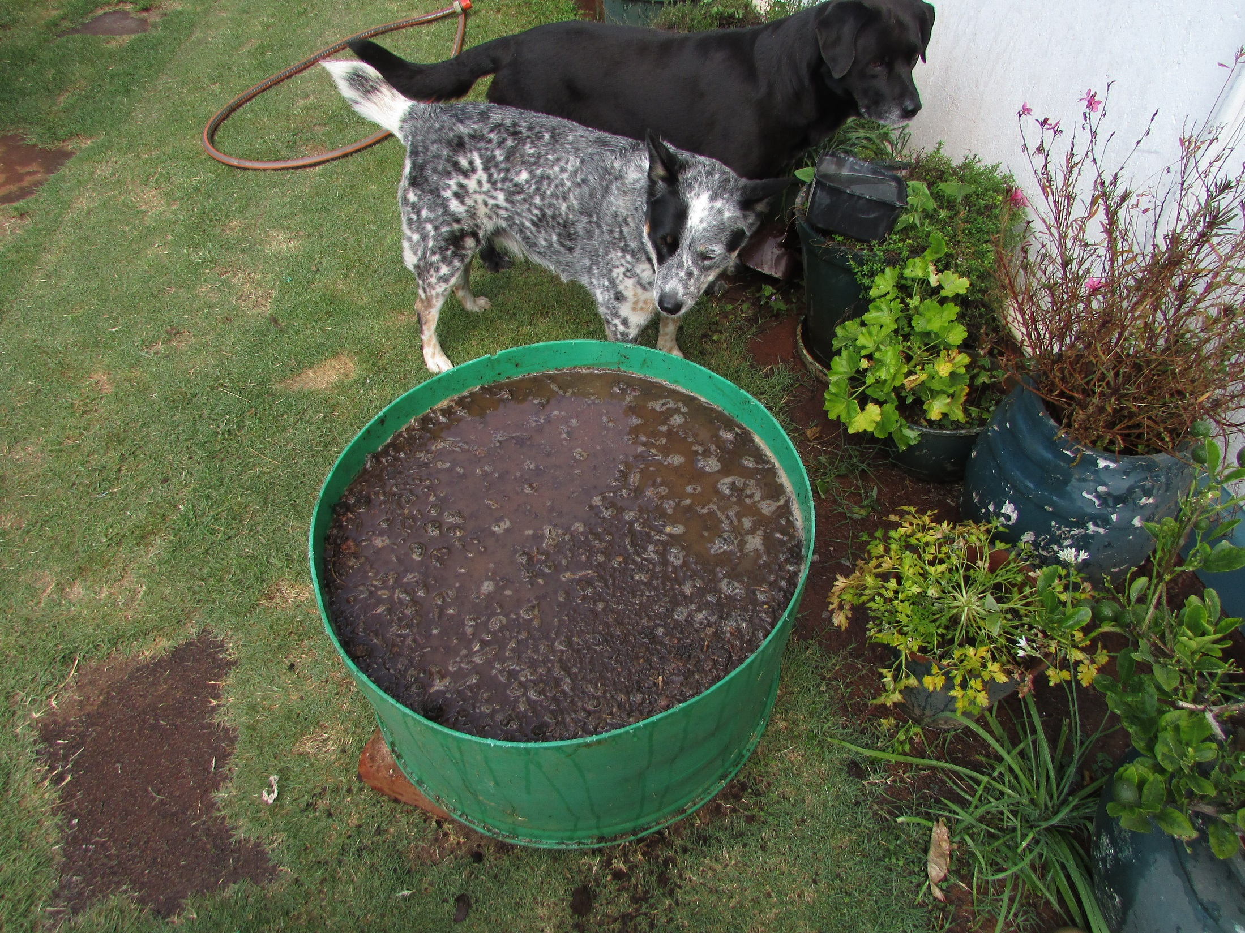
water

Slide 11
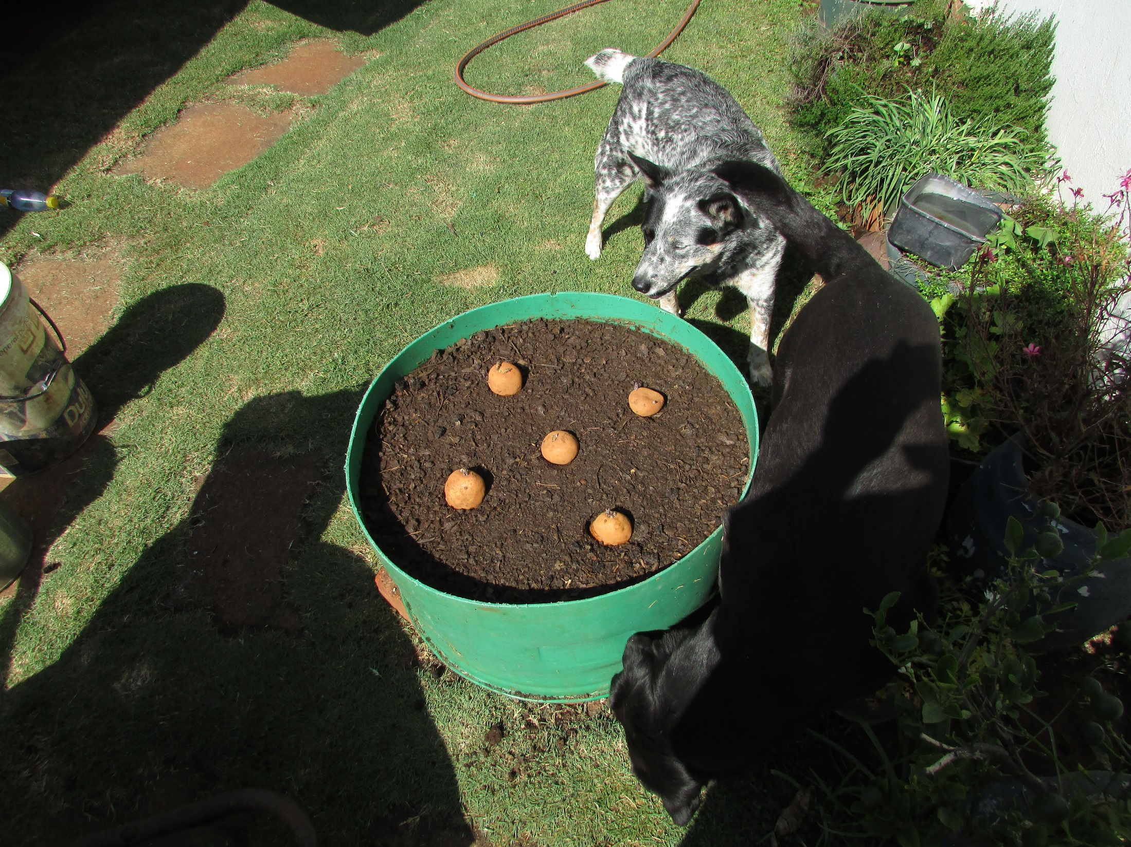
Add 5 seed potatoes

Slide 12
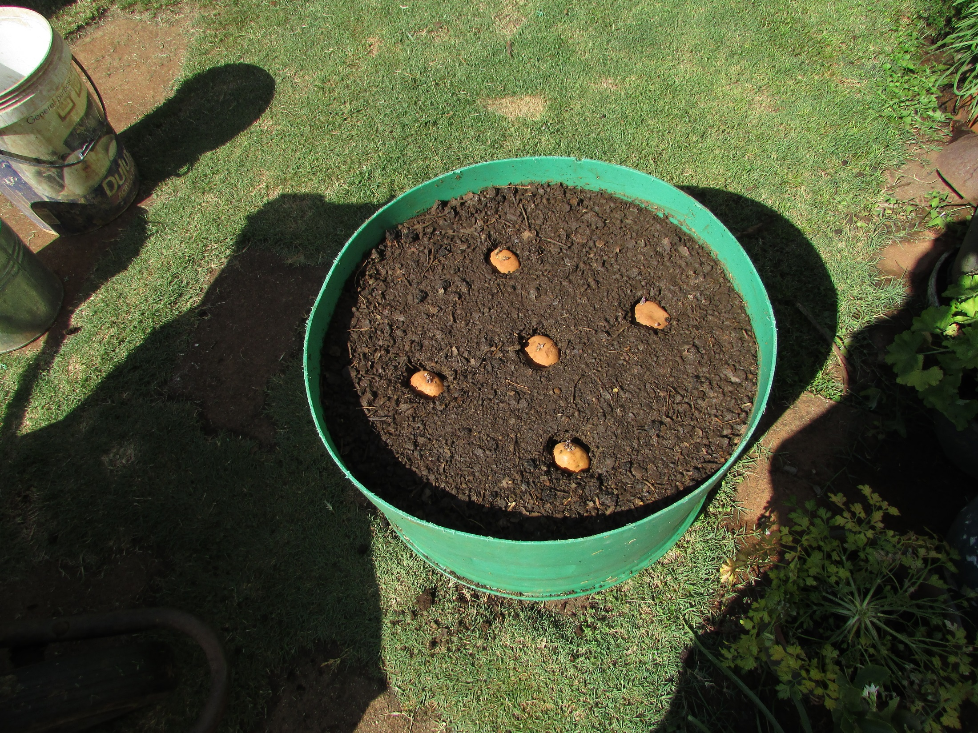
Press into soil with
growing nodes up
and cover with
about 80mm of soil

Slide 13
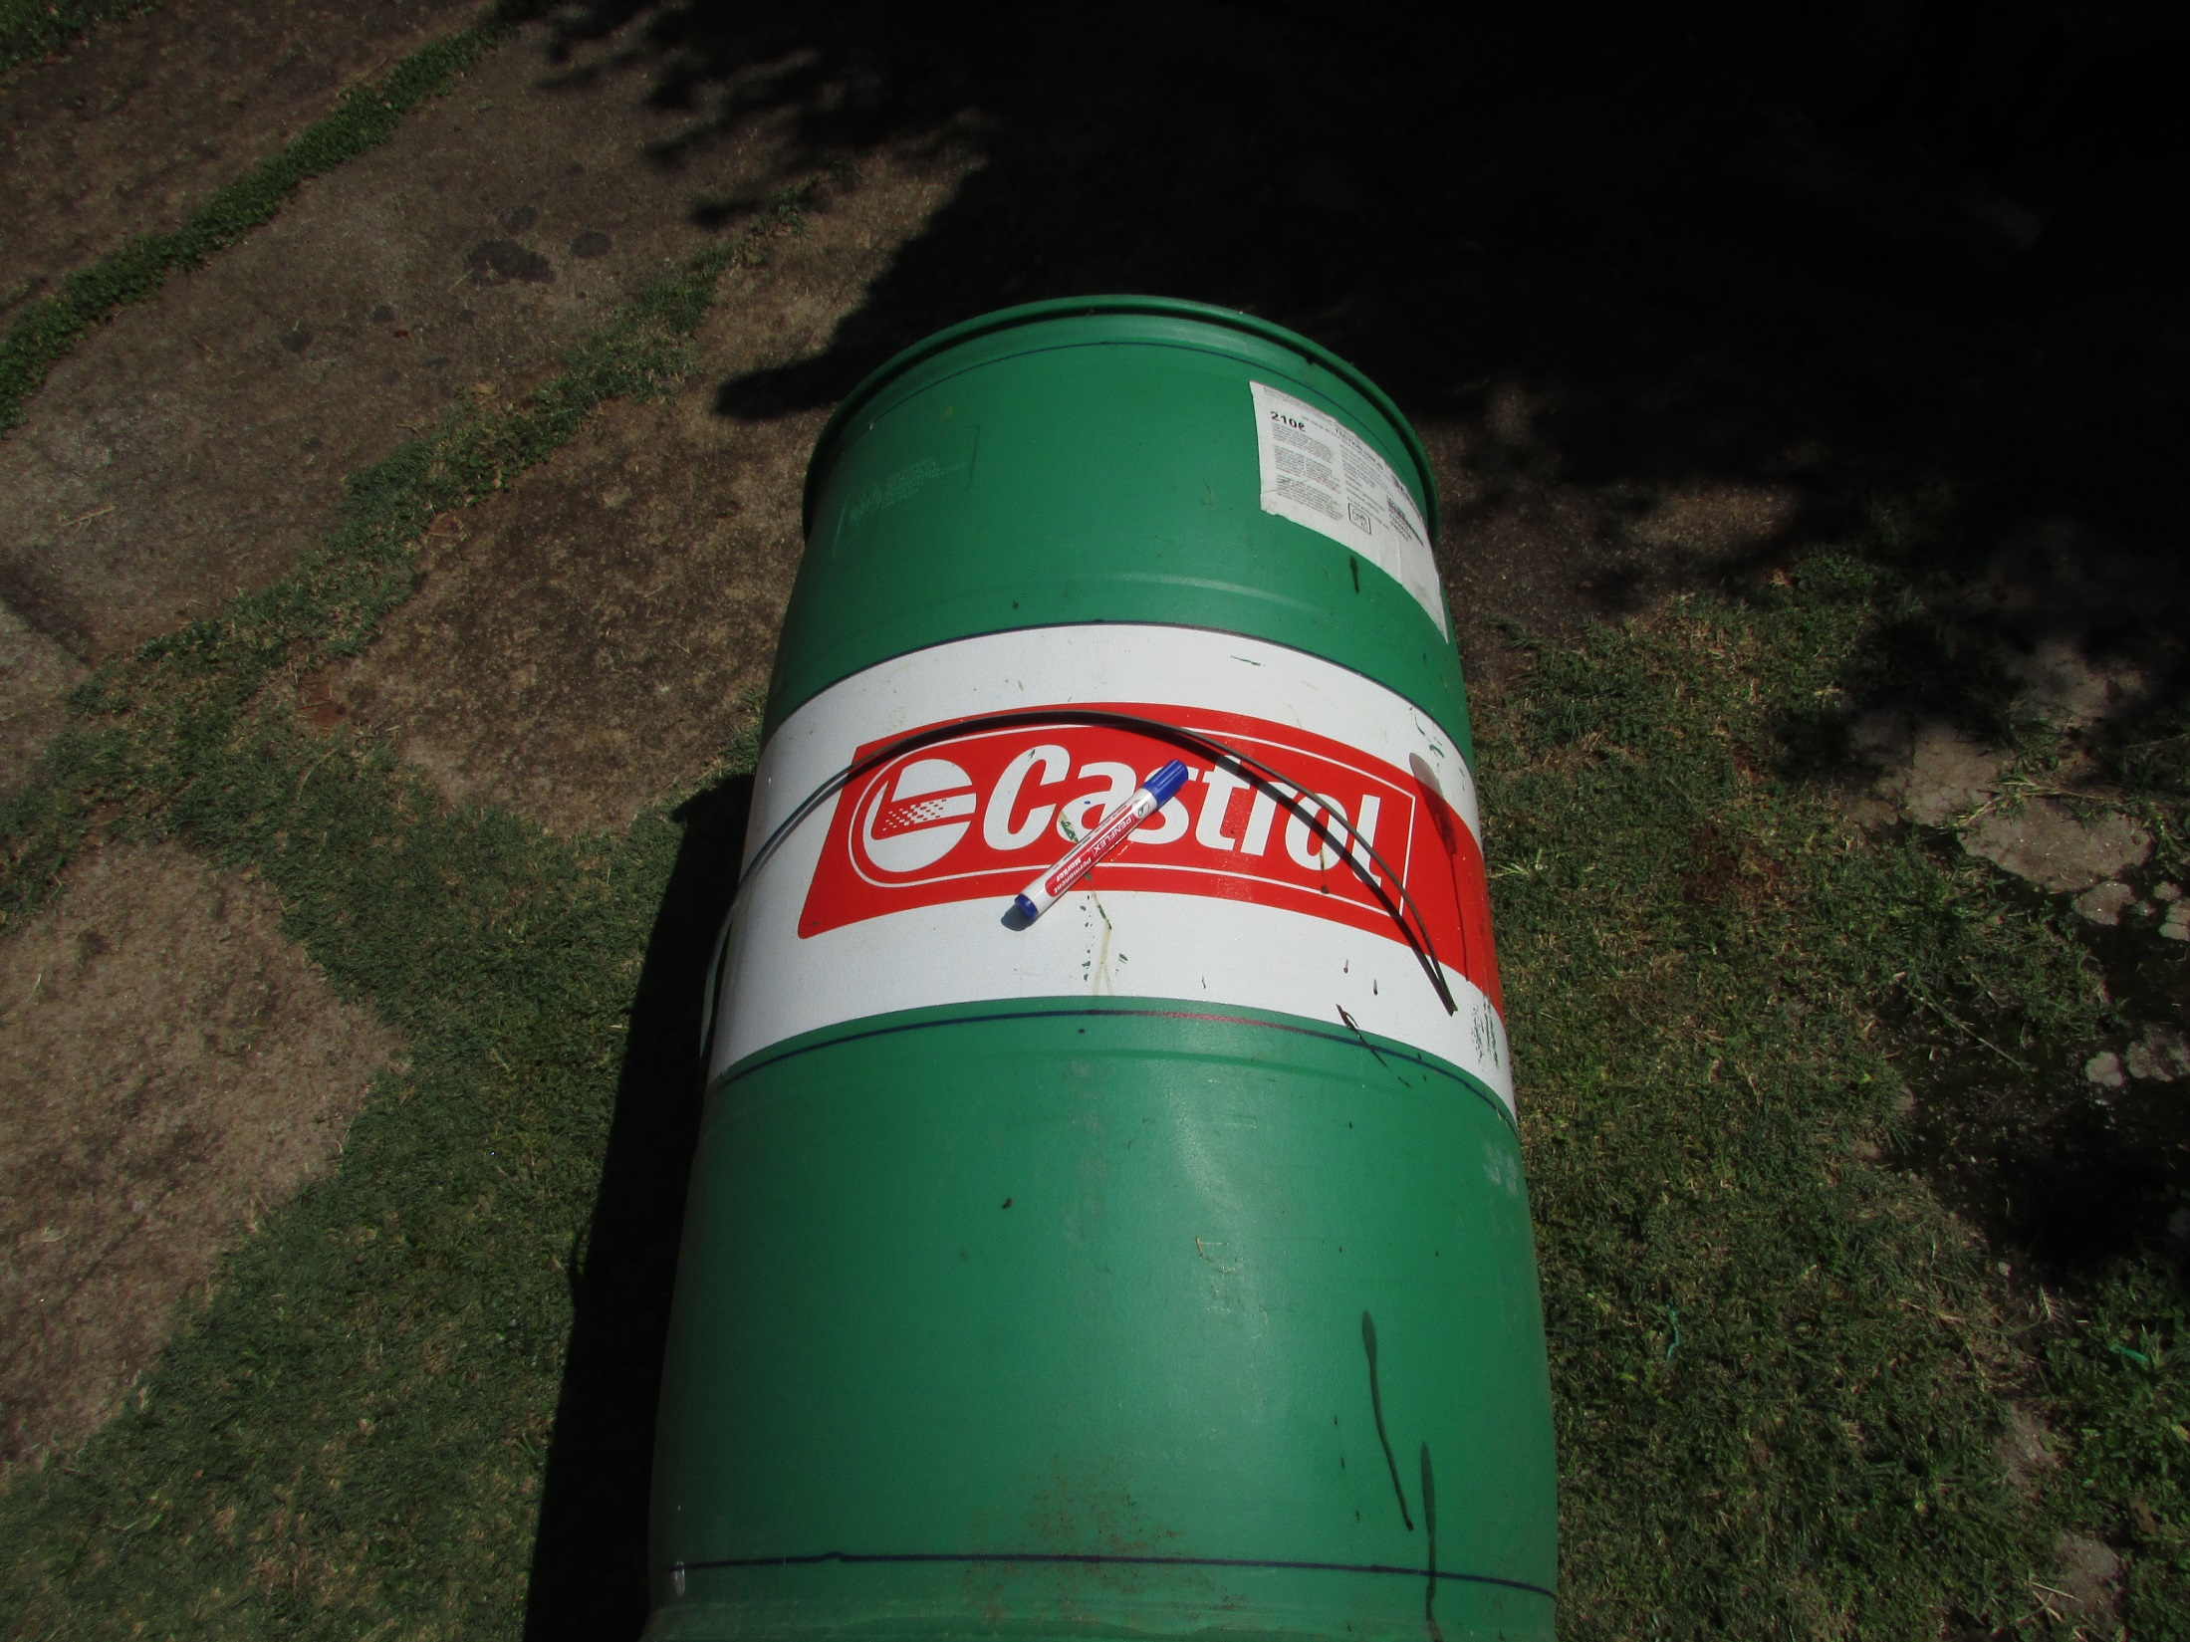
Make a marking jig and
mark cut lines to remove
the top and the bottom
of the second drum
and divide the remainder
into three sections

Slide 14
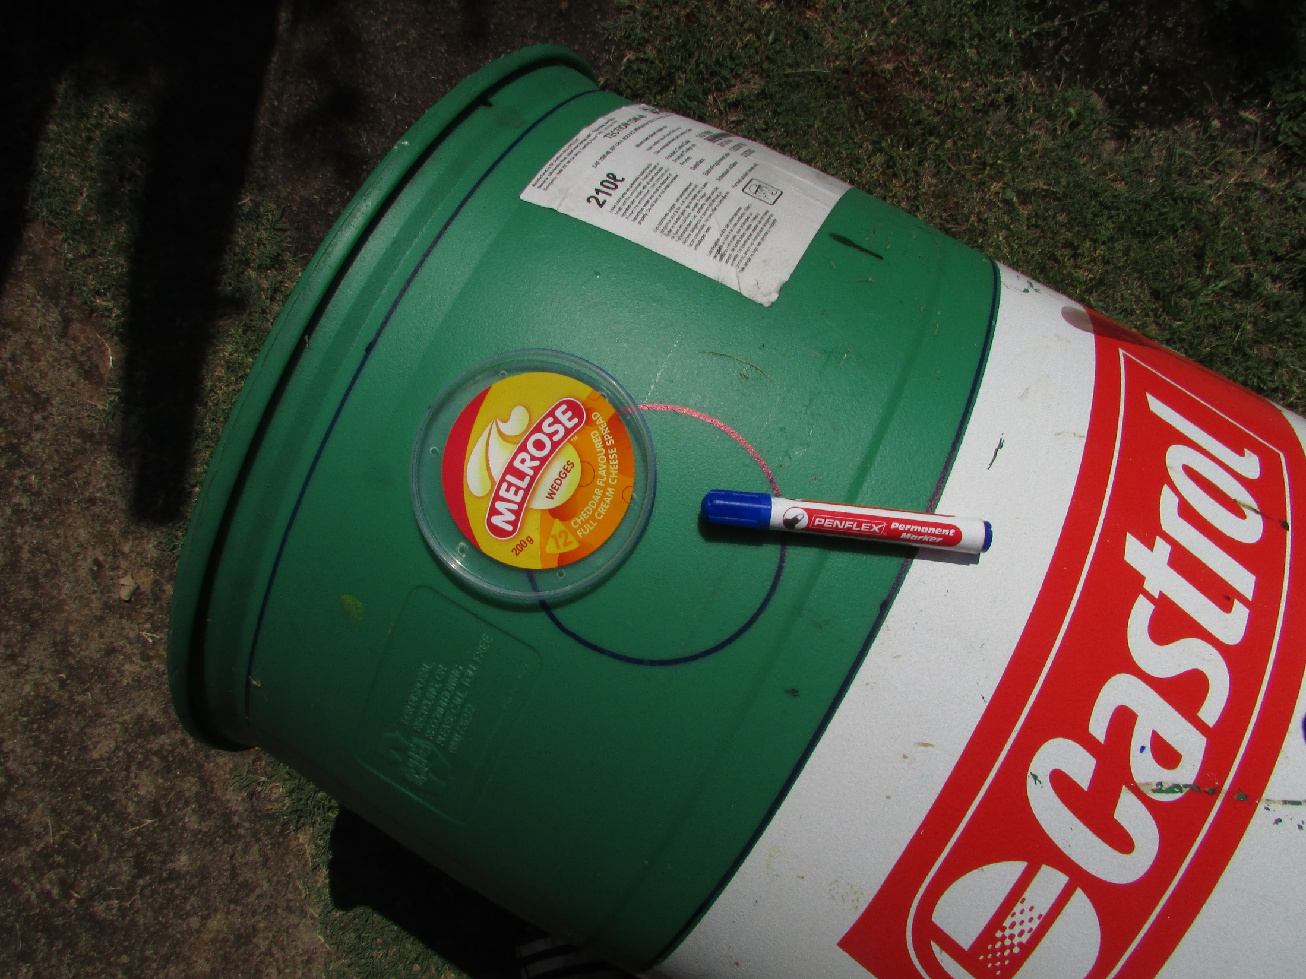
Mark three “hunger holes”
in each section

Slide 15
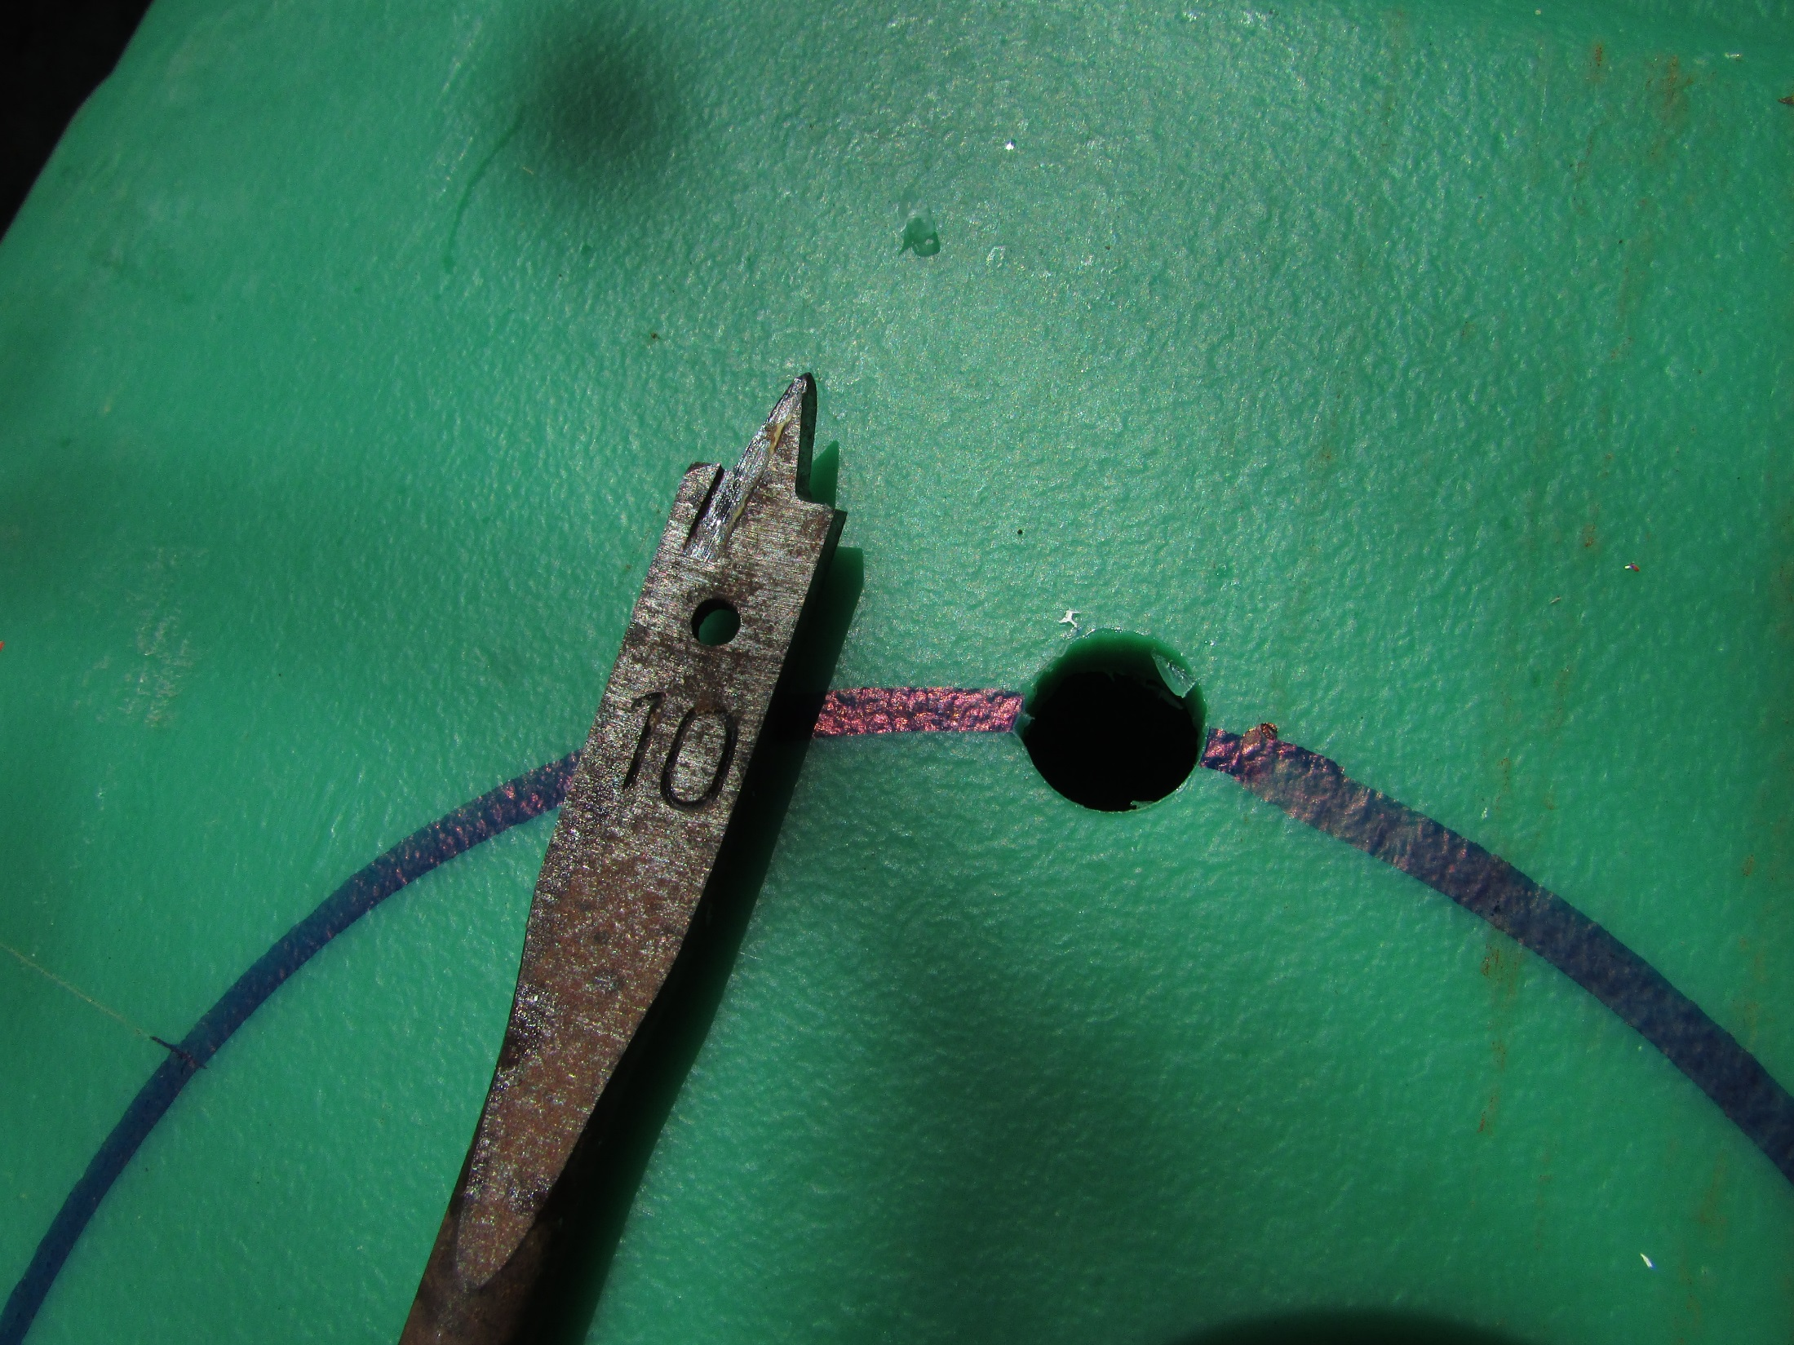
10 mm starter holes

Slide 16
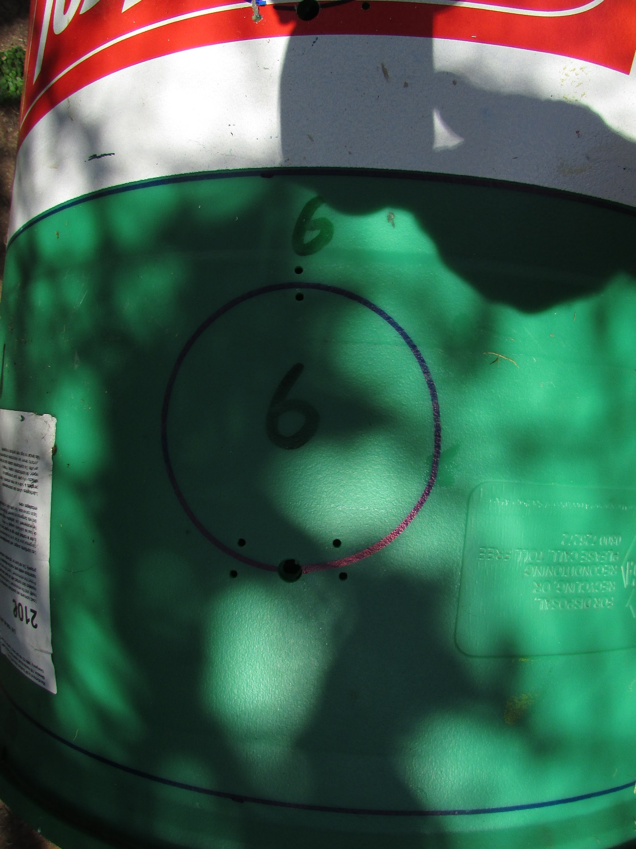
Drill hinge holes

Slide 17
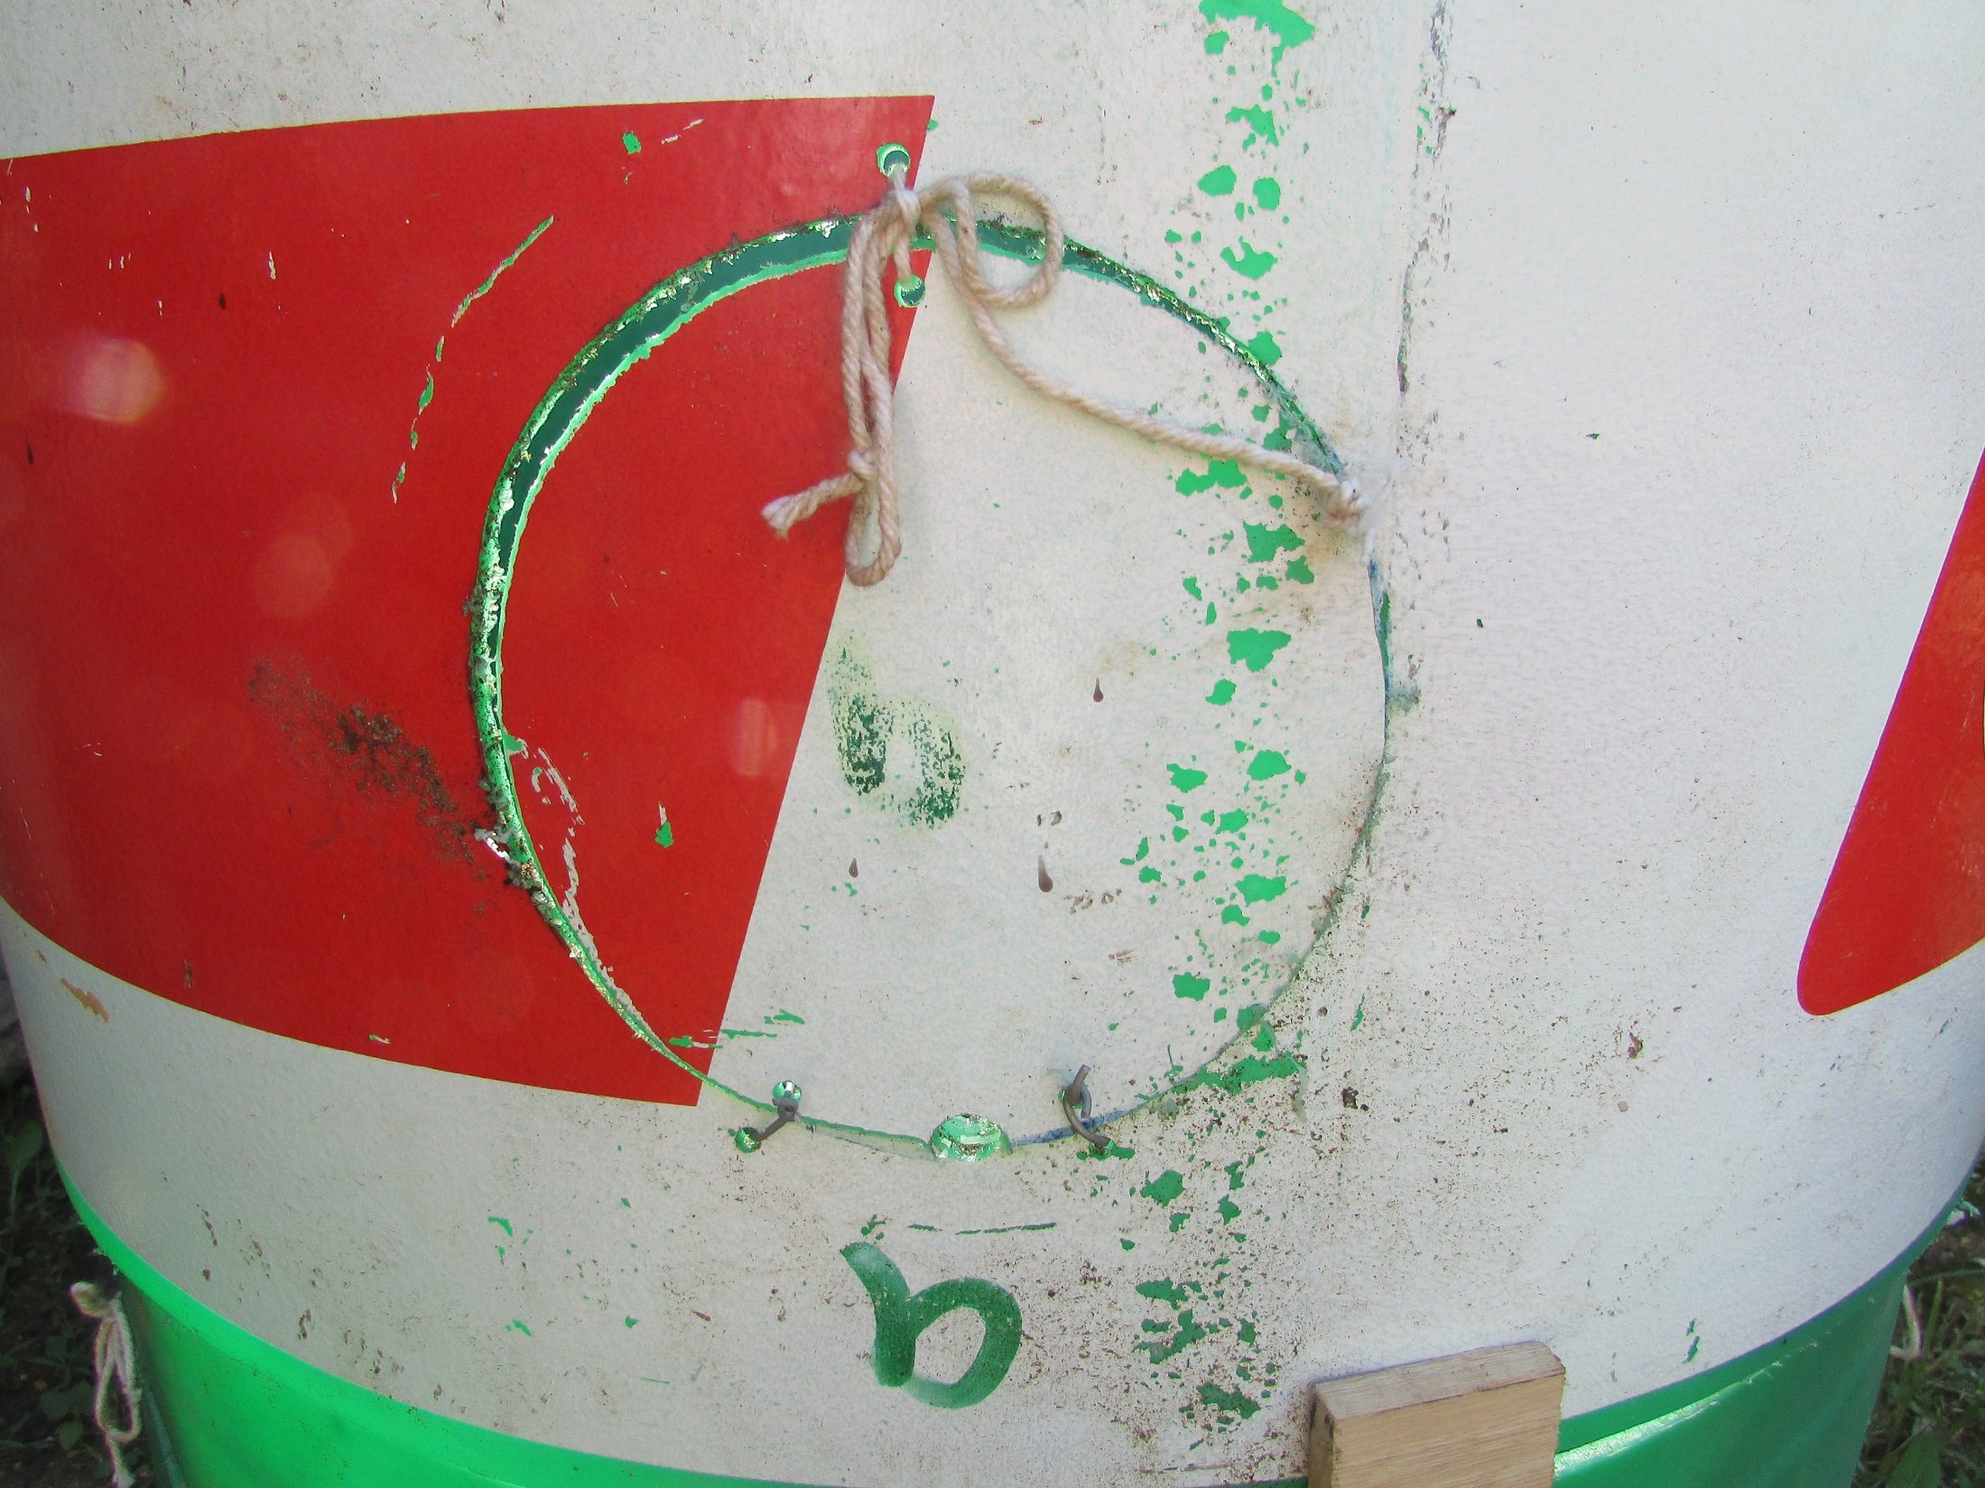
Cut and add hinges and string

Slide 18
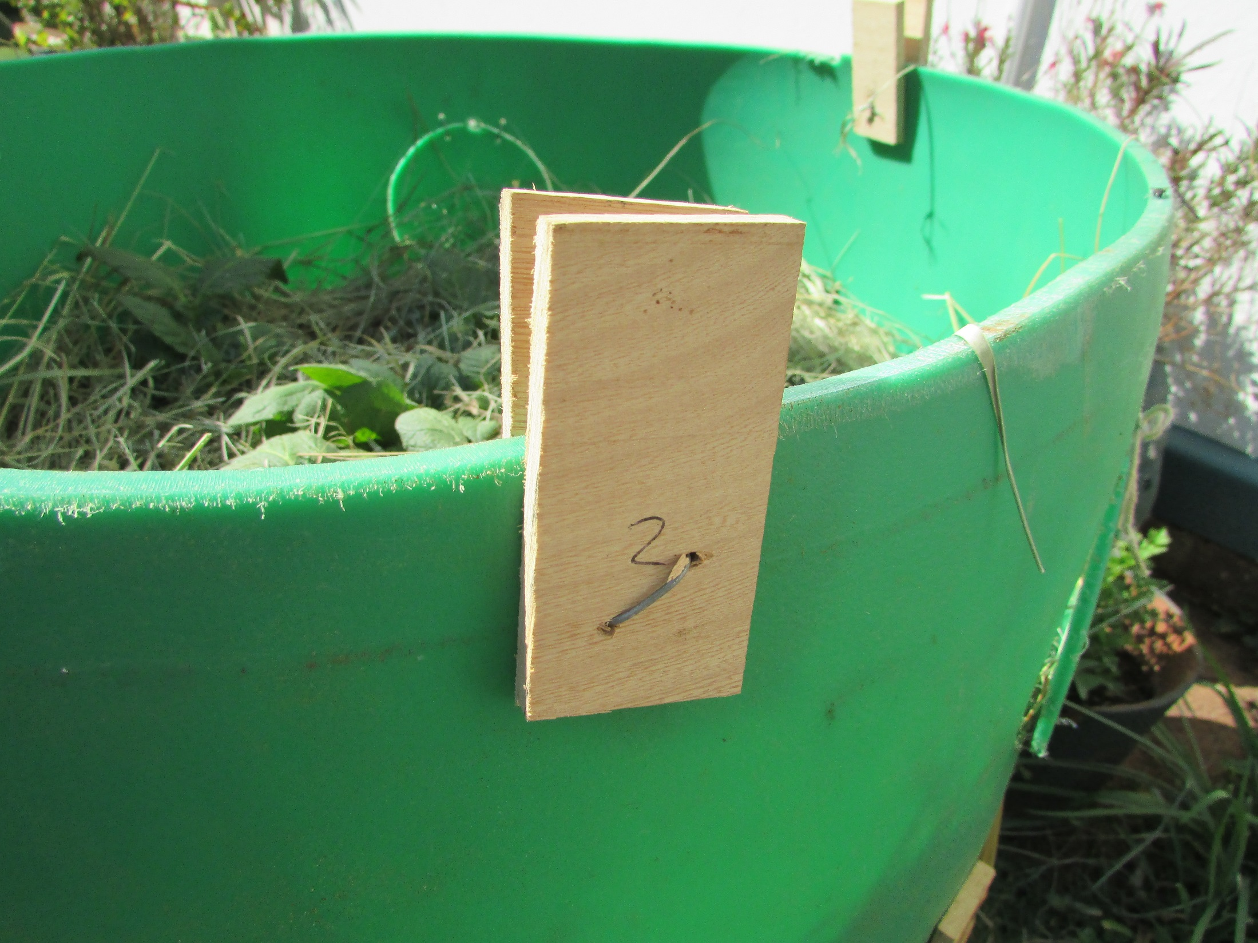
Make a system to hold
the next section in place

Slide 19
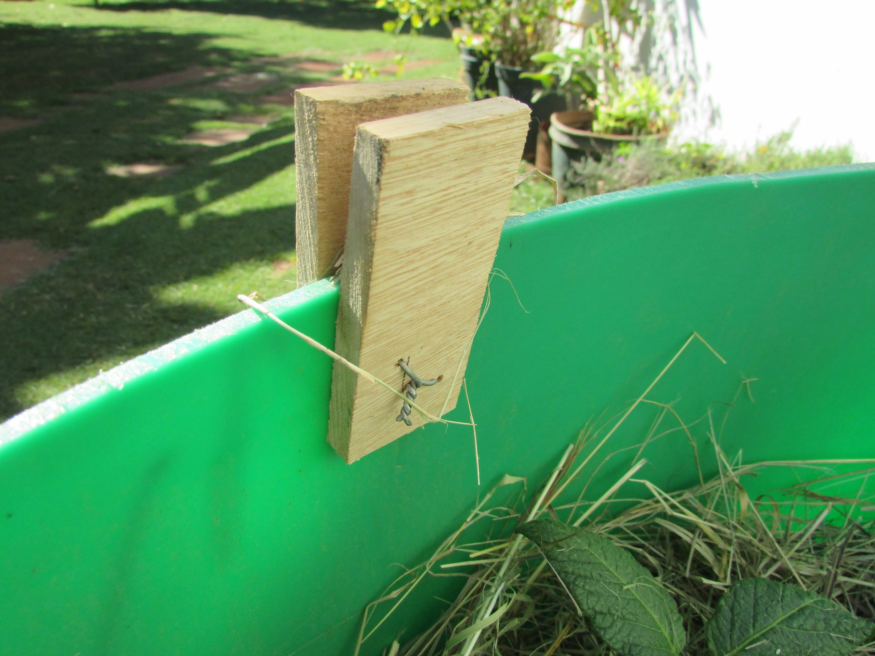

Slide 20
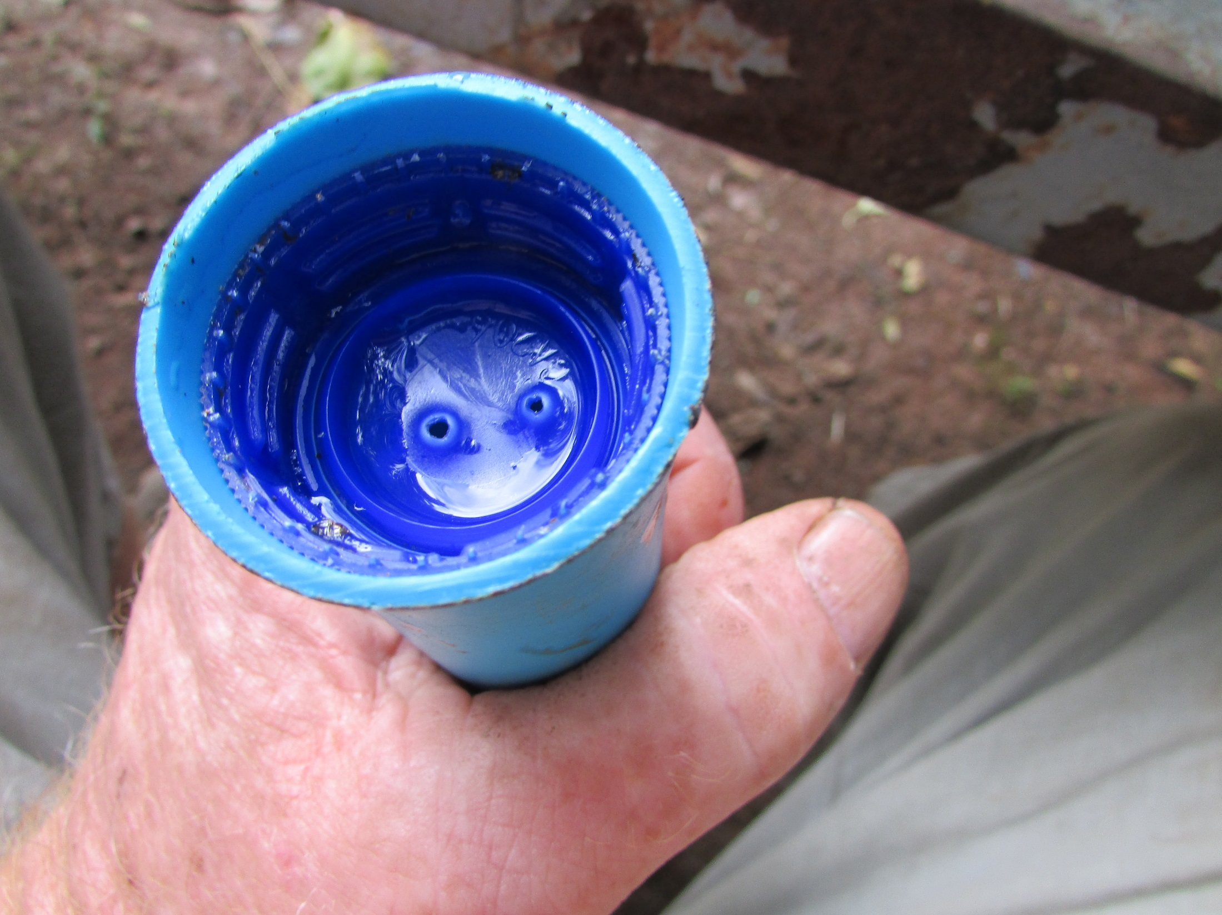
Make an irrigator with a
bottle top heated into
the end of a 40ml pipe

Slide 21
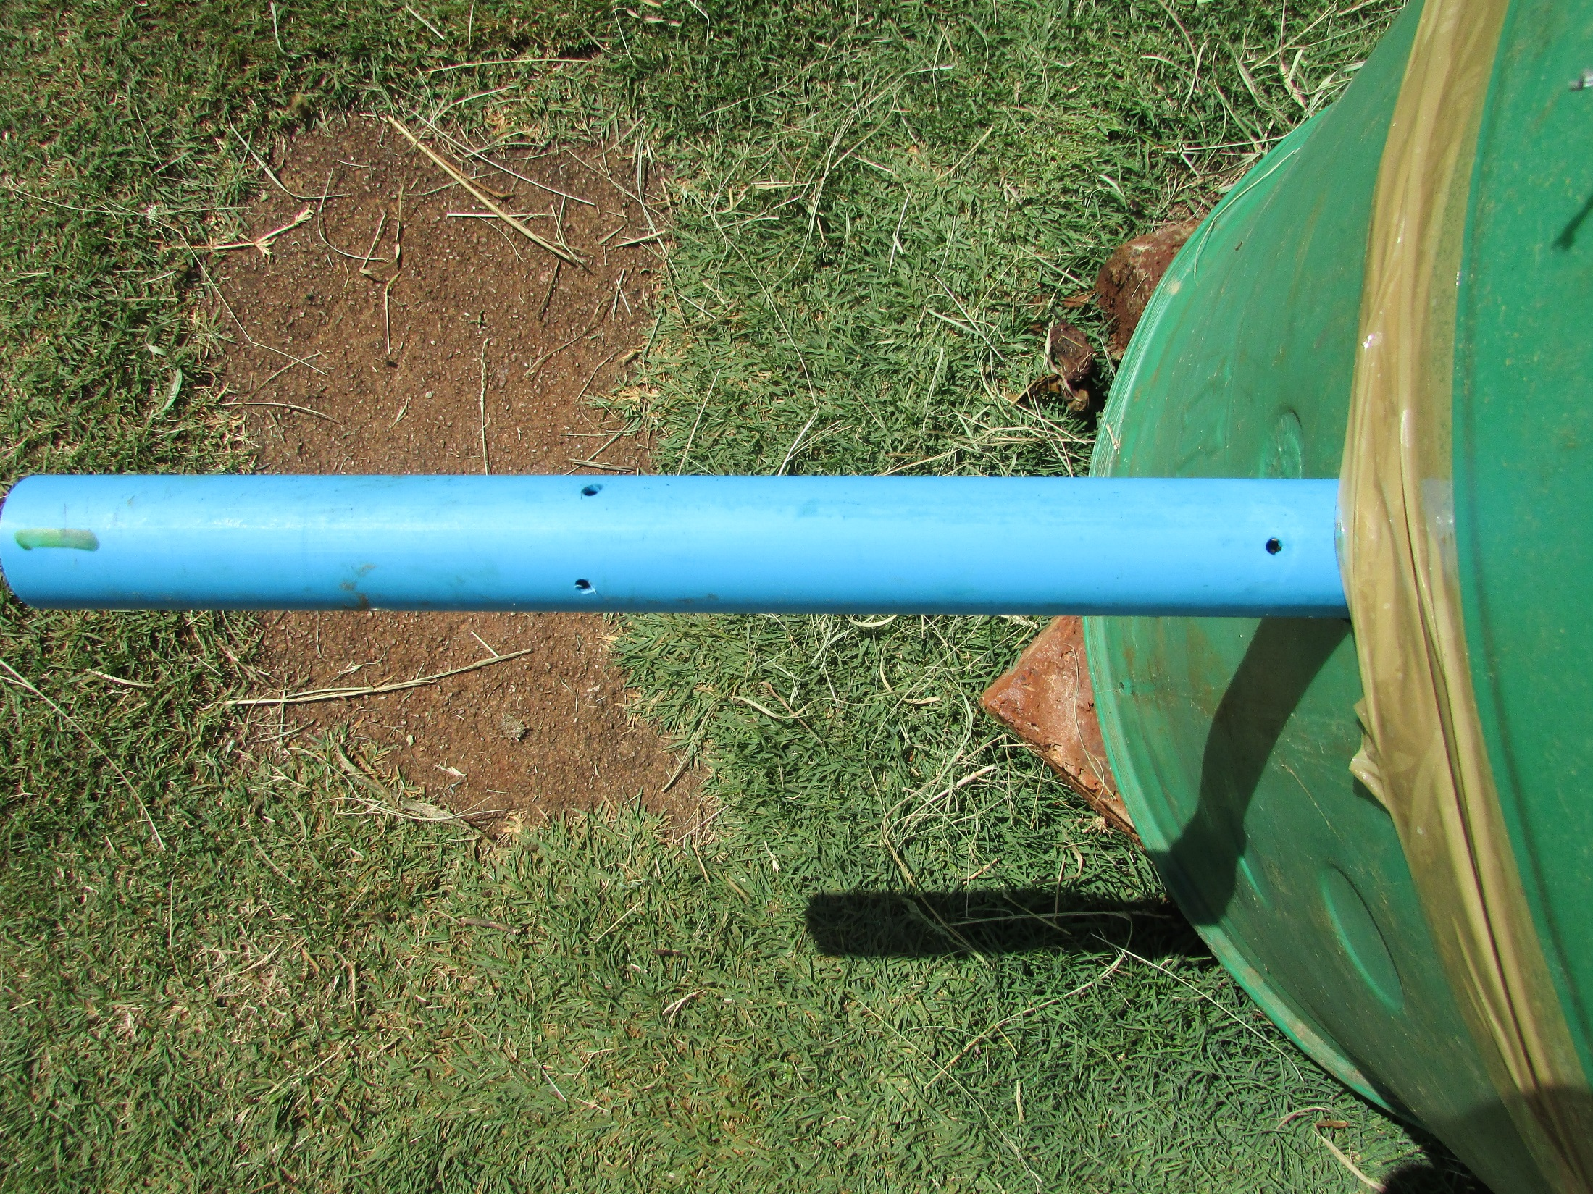
Drill other holes so that
each plant gets water

Slide 22
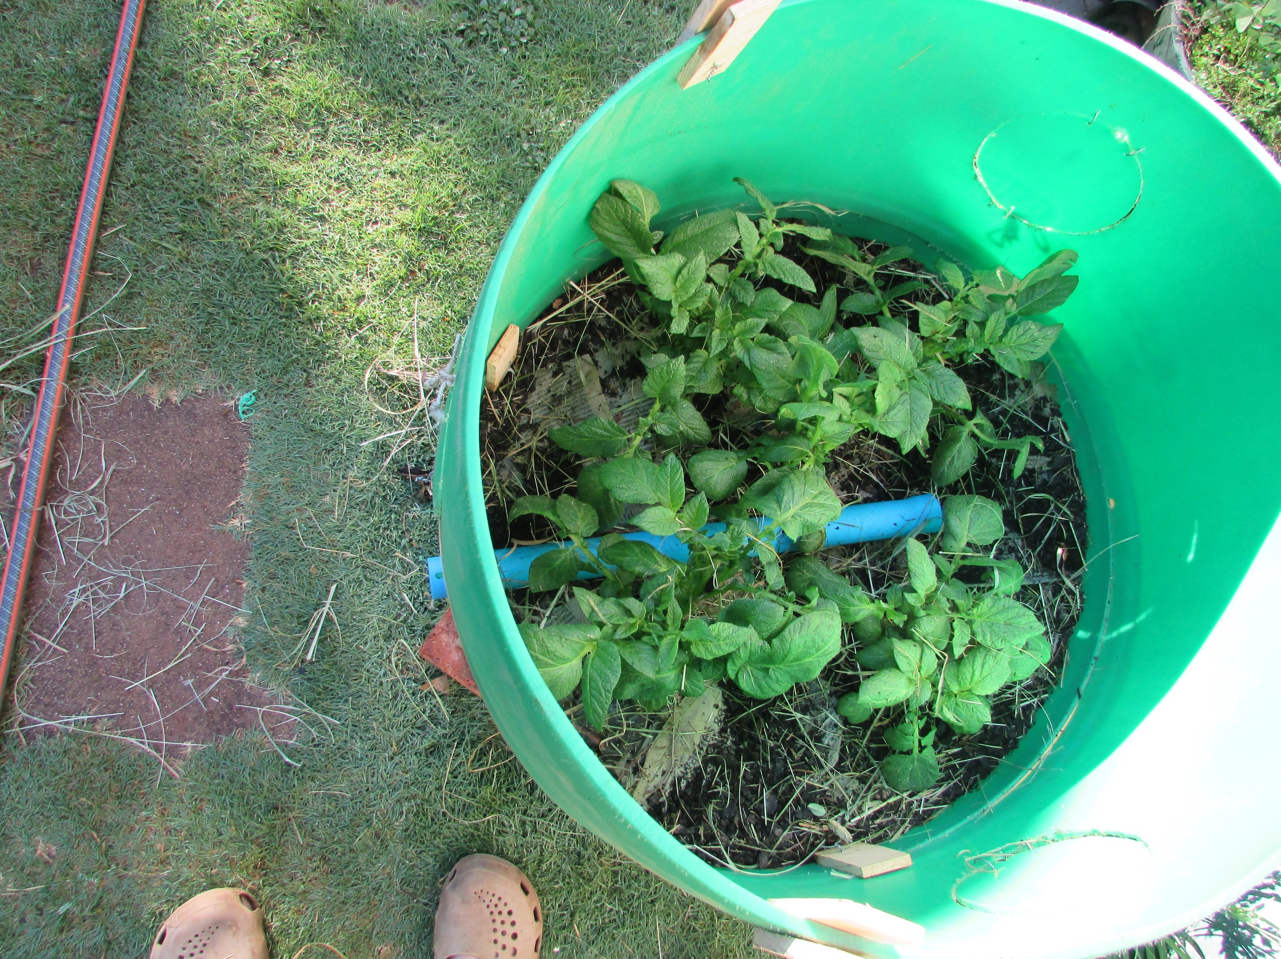

Slide 23
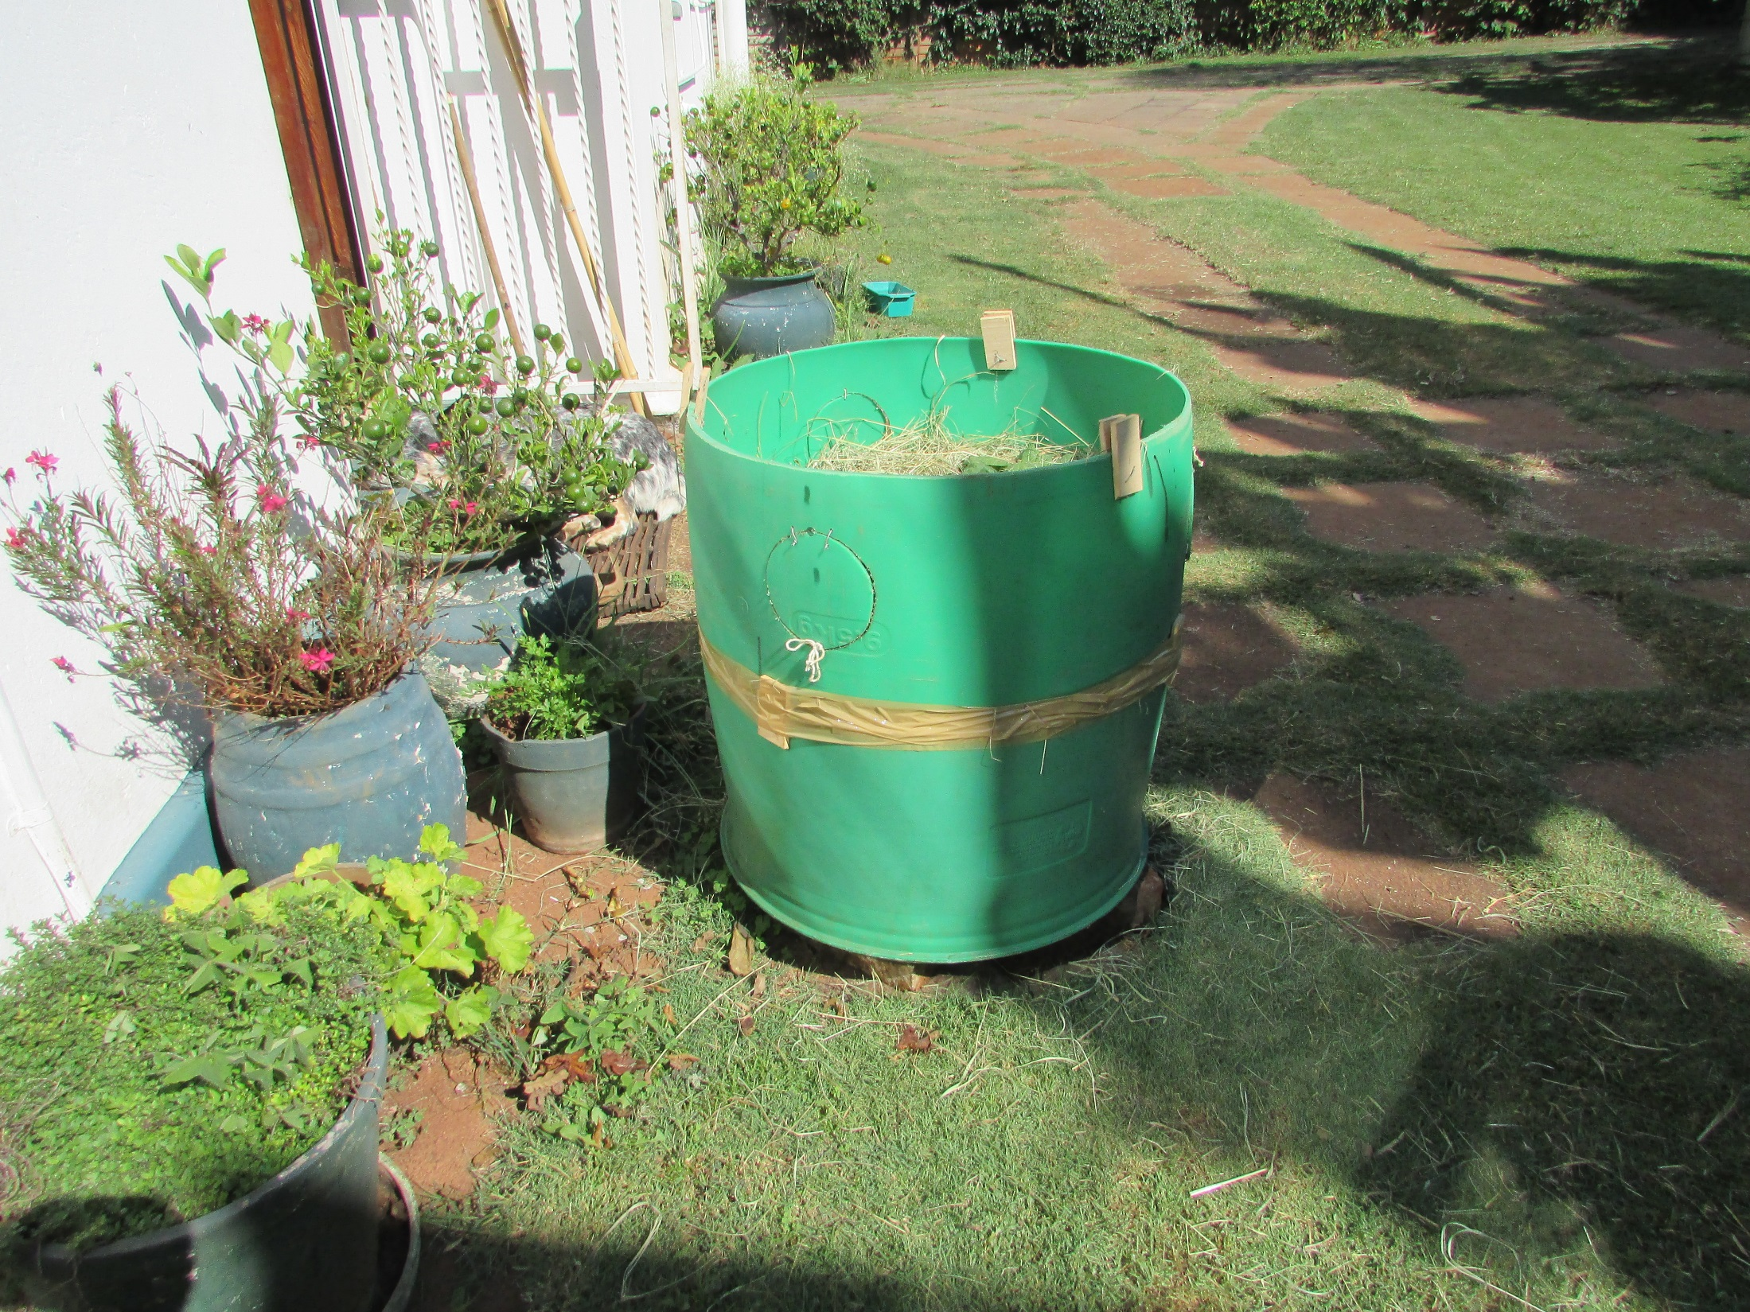
Tape the join (optional) if
the fit is bad.

Slide 24
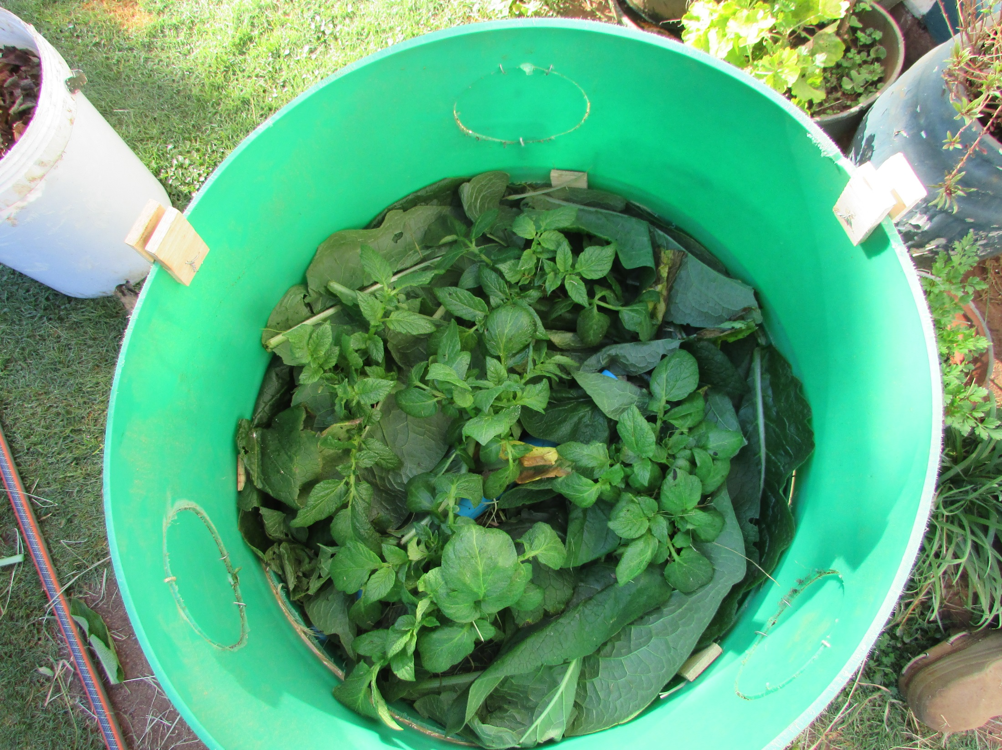
Mulch with comfrey leaves

Slide 25
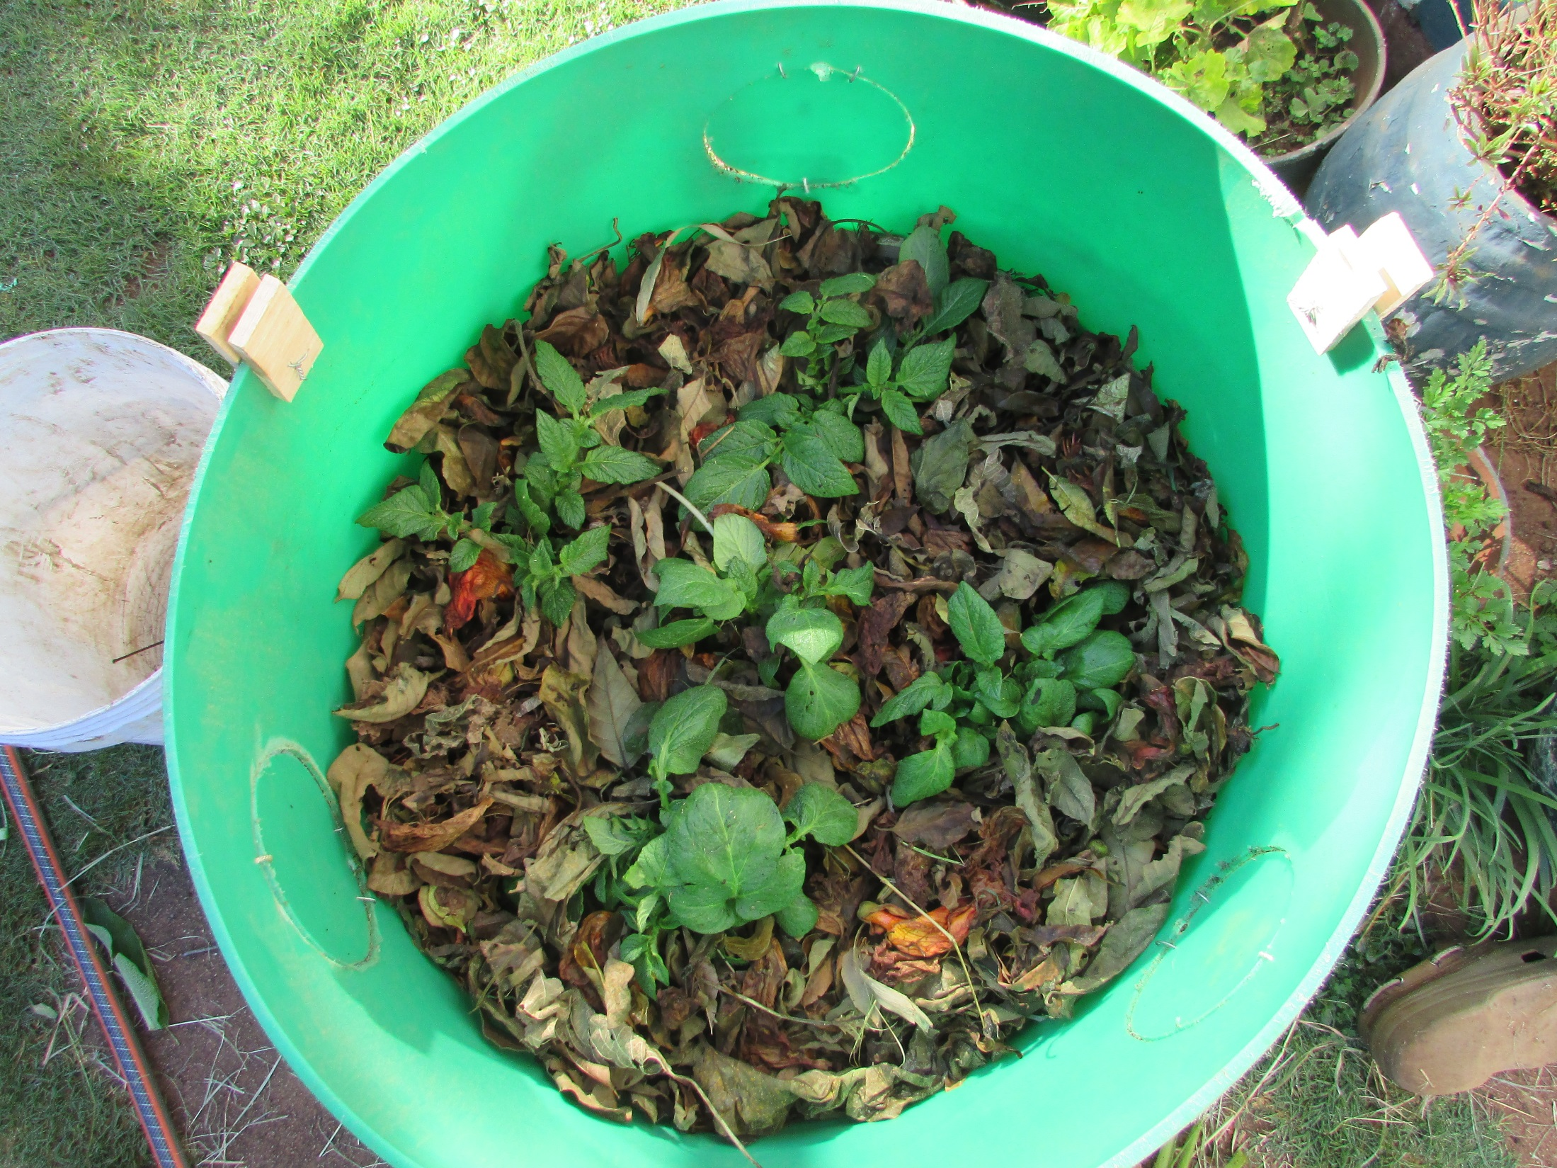
Mulch with leaves

Slide 26
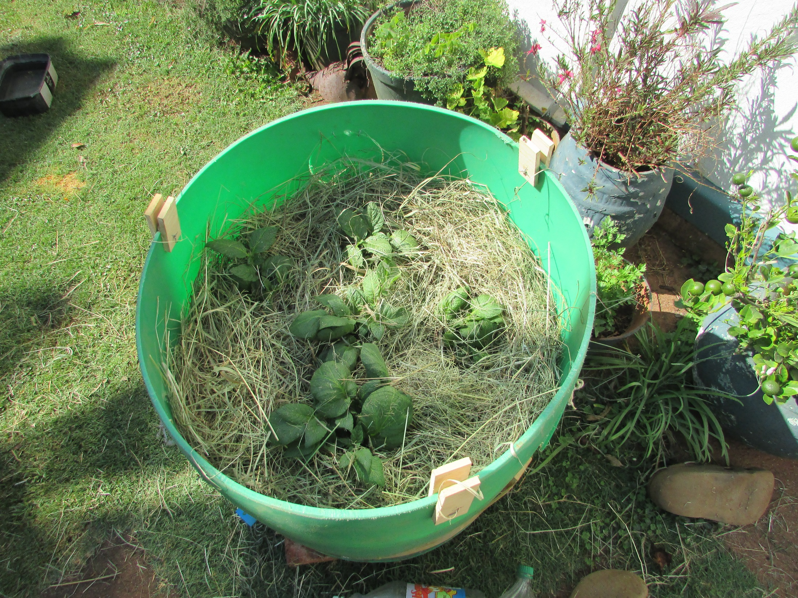
As the plants grow mulch
with straw.

